Slide 1
Shack Earthing Safety
Trevor G7REV

Slide 2
Earthing in General
We need to consider earthing as two different systems:
1 Safety Electrical Earthing (Mains Power)
2 RF Equipment and Antenna Earthing

Slide 3
Once Upon a Time…
Houses where illuminated by Gas Lights and Candles.
Up until the 1950’s Electricity in homes was considered an alternative to Gas lighting, and so only light fittings and possibly one power point were provided in a house.
As people got more affluent, they bought electric irons, wireless sets, etc, and some of us will remember two pin plug light adaptors being used to power these.
Most equipment was metal cased, and any electrical fault to the case was a fire and shock hazard.

Slide 4
Safety Electrical Earthing
The solution to the shock risk was to tie all exposed metal work to an earthing point, so any case fault could not raise the case voltage above earth potential, and the fault current could ‘Blow’ the fuse.
Hence the three pin mains plug was born.
Originally the 2 amp, 5 amp, and 15 amp round pin plugs were used.
Later, the now standard, 13 amp square pin plug was introduced.
So the consumer did not have to pay to have an earth rod installed at their premises, the supply authority provided a central earth point at the substation.

Slide 5
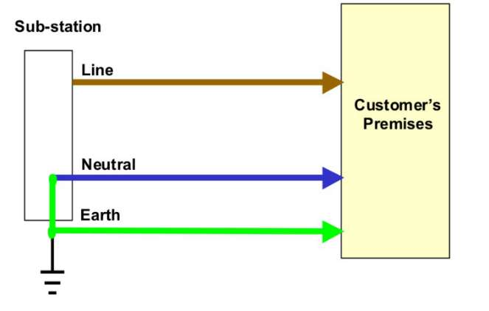
Safety Electrical Earthing
This original system was called TN-S
TN Terra(Earthed) Neutral
S Separate earth conductor
It normally used the lead sheath of the supply cable as the Earth conductor.

Slide 6
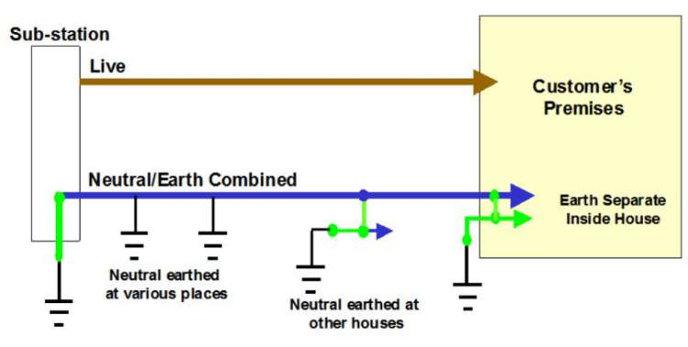
Safety Electrical Earthing
As Lead Covered cables were discontinued in the late 1960’s there was a need to come up with another way of carrying the Earthing conductor. This is the TN-C-S
TN Terra(Earthed) Neutral
C Common Earth Wire with Neutral, regularly Earthed.
S Separate earth conductor
The earth in the premises is still a separate conductor.
This is also called PME.

Slide 7
PME Special Note
When Undertaking Network Repairs and Modifications most Distribution Network Operators (Electricity Boards) now bond the neutral and earth together, even on old cables.
It is advised to always treat domestic supplies as PME unless it is definitively proved otherwise.

Slide 8
Regulatory Concerns
It is against the Electricity Supply Acts for anyone not certified to alter the earthing arrangements of an installation.
In England and Wales, Part P of the Building Regulations (Electrical Installations) requires most work done under Part P is notifed to Building Control, and be inspected and tested.
NB Part P also requires that any additional earth Electrodes shall be notified to the Buildings Inspector and must be inspected and tested.

Slide 9
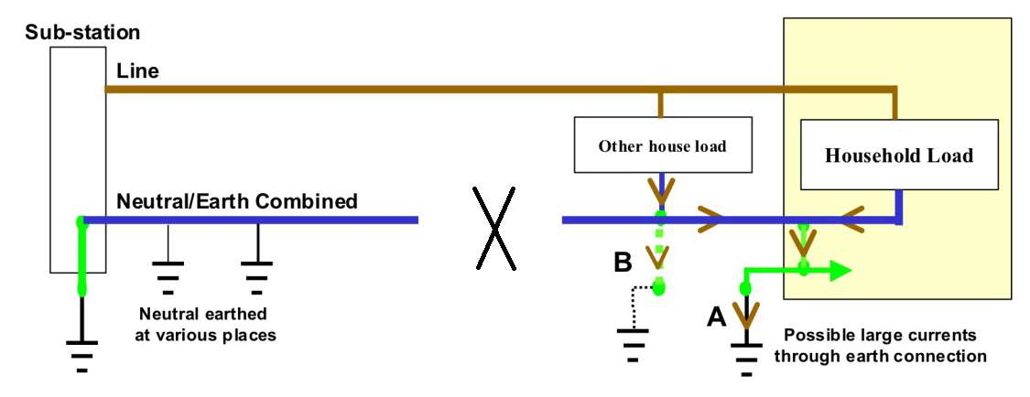
The Problems with a TN-C-S System
If the common Earth Neutral Conductor breaks, then all the return current from all equipment can only return to the transformer via the earth.
It will take the lowest resistance path to earth, even if it is your earth spike via your transceiver!

Slide 10
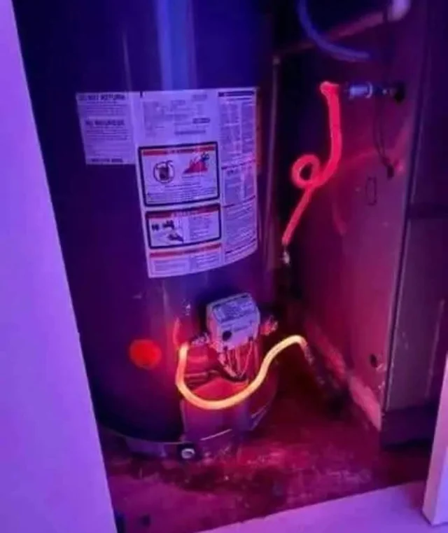
The Problems with a TN-C-S System
An example of the building load from a Common Earth Neutral Fault finding the best path to Earth via an immersion heater tank!

Slide 11
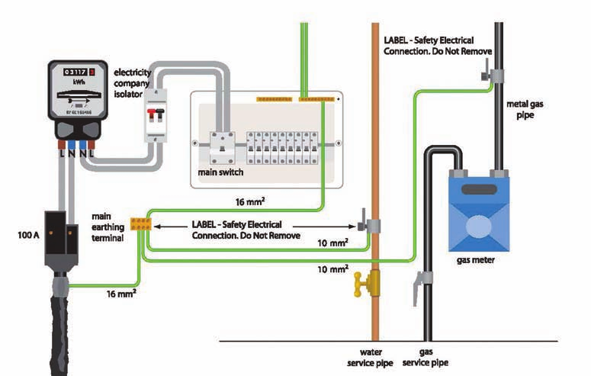
Safety Electrical Earthing
What happens if there is a problem with the earthing, or there is a better earth is introduced by Water or Gas pipes, etc?
There is a danger of shock between the exposed metalwork, and the pipes.
Every conductor (Pipes etc) entering a building must also be connected to the electrical earth so they are at the same potential.

Slide 12
Antenna and RF Equipment Earthing
Why do we need to provide RF Earthing?
To provide a counterpoise for Vertical and End Fed Antennas
To safely ground return currents from high SWR systems
Ground RF in the shack Safely
Safety earth for RF Cable faults

Slide 13
Problems with Earth Spikes
If you have an earth spike, it must be bonded to the mains earth. Otherwise there is a shock risk between your RF earthed equipment and the cases of your mains earth equipment.
Mains earths may be electrically noisy, and connecting this to your shack earth will contaminate your reception.
A wire from an upstairs transceiver to earth can be high impedance, or resonant in its own right!

Slide 14
How to Minimise Risks
Only use Earth Free antennas (Balanced antennas such as a Dipole)
Use an ‘Earth Free’ Vertical Antenna mounted clear of the ground, i.e. use a radial system.
Operate POTA or SOTA
If you have a detached shack get a qualified person to separate your shack from the mains earth, and use a local earth spike for both Electrical and RF Earthing!
Use insulated radials embedded in the earth.
‘Artificial Grounds’ I do not know the legality of these in the UK.

Slide 15
Embedded Radials
If you embed a length of single core cable in the ground it can provide an adequate RF Ground. The radial must be buried deep enough that the surrounding ground is always wet.
The capacitance of a buried single core cable to earth is similar to RF58 at 100pF per meter.
At 1Mhz the reactance is about 15Ohm per meter. At 50Hz it is 3MOhm.
The cable is a short circuit at RF, and Insulative at mains frequency.
Keep this earth separate from any electrical earth.

Slide 16
Important Note
These notes are just for guidance.
You need to contact a professional regarding ANY Earthing you provide in your shack.
See free RSGB Leaflets:
EMC-Leaflet-7-Earthing-and-the-radio-amateur-Basic-Version-6.6-April-2025
EMC-Leaflet-7-Earthing-and-the-radio-amateur-Advanced-Version-6.8-April-2025

