Slide 1
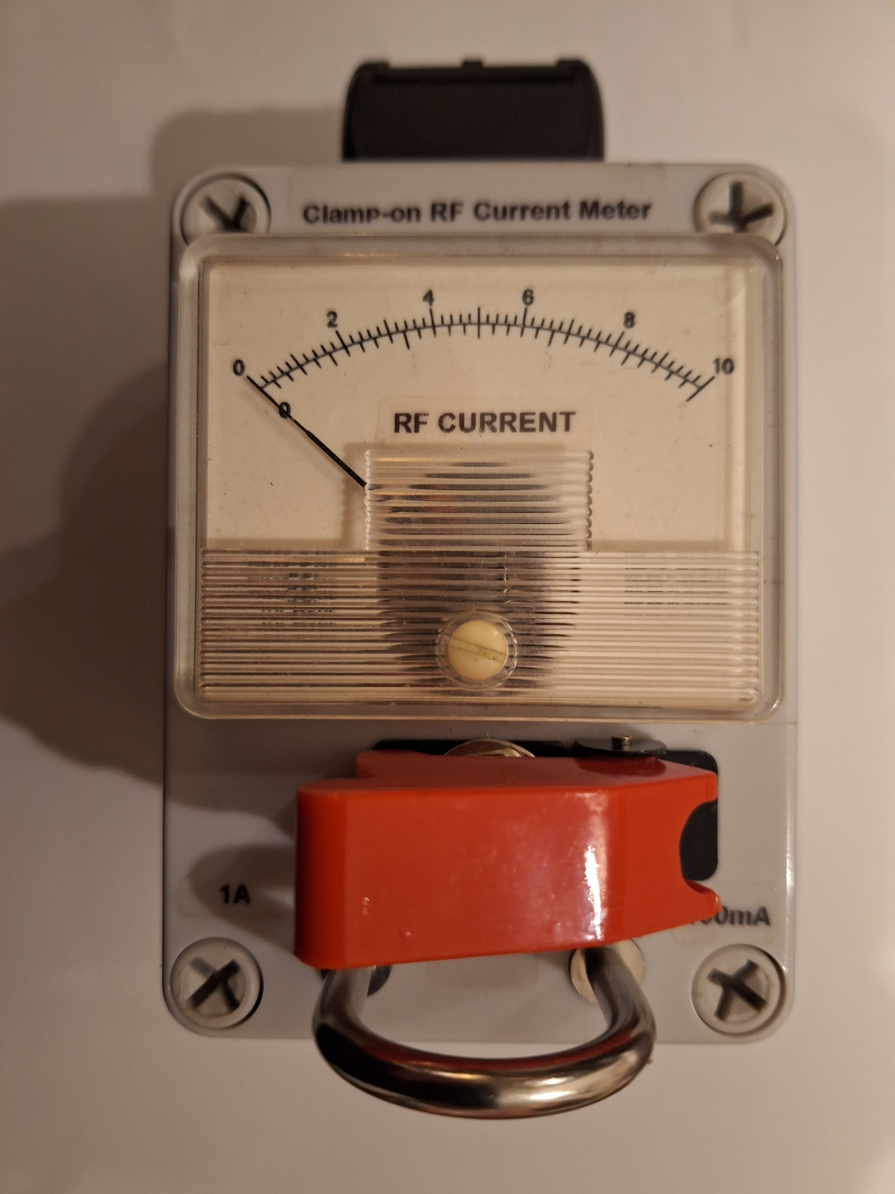
Show and tell by M0PWS
RF Current Meter

Slide 2
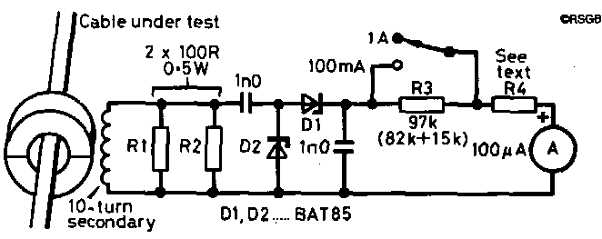
http://www.ifwtech.co.uk/g3sek/clamp-on/clamp-on.htm

Slide 3
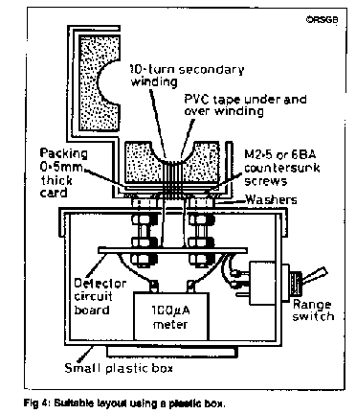
Construction Layout

Slide 4

Toggle switch safety cover

Slide 5
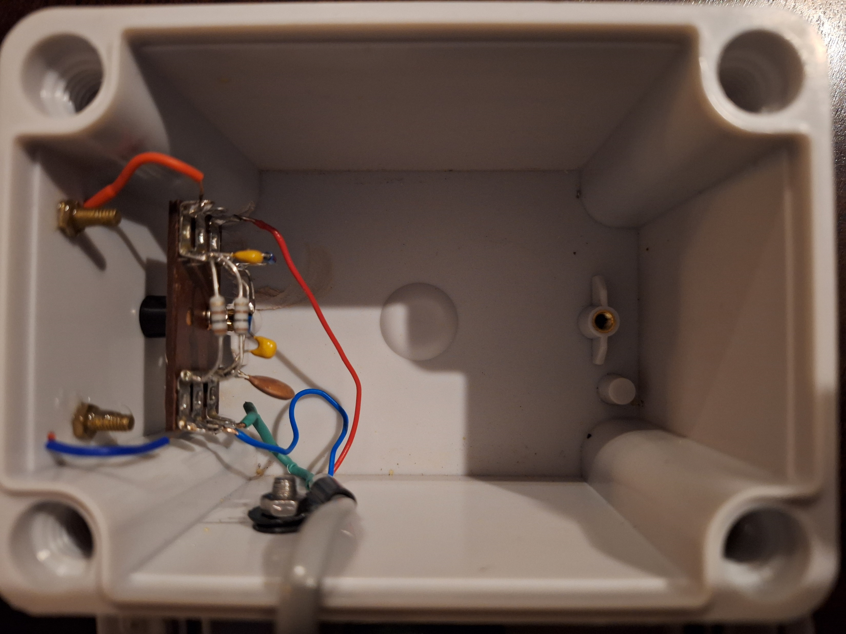
RF Components on project board

Slide 6
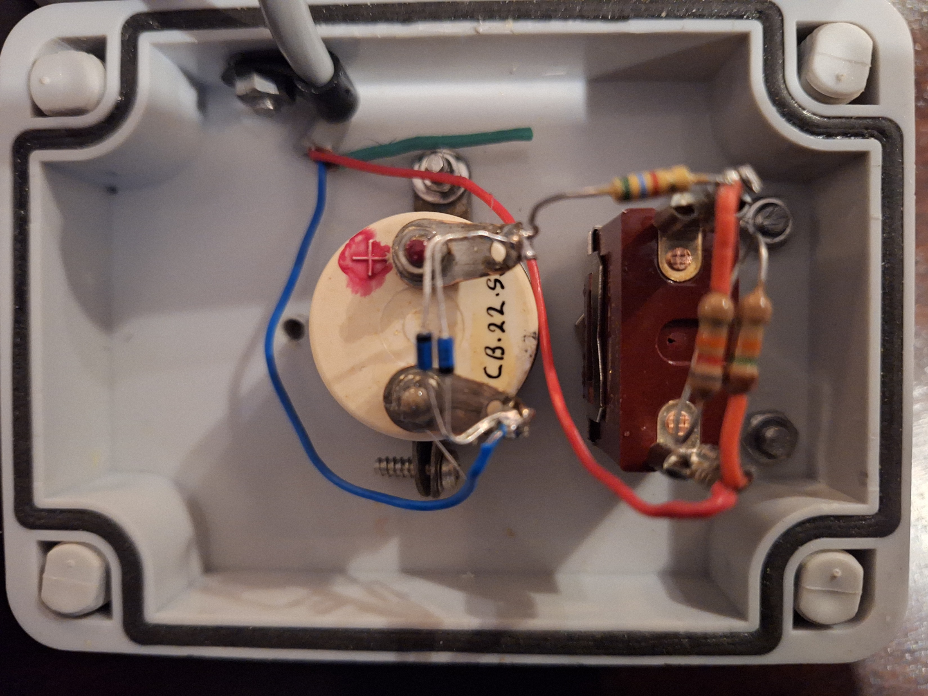
100 uA DC Meter & range components

Slide 7
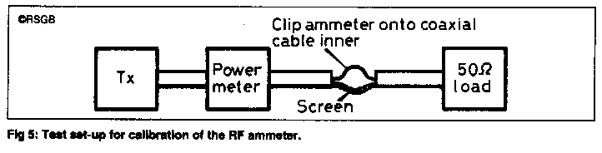
Checking calibration
Note: For RFI work, tracing unwanted stray currents, you can see useful indications all the way up to 432MHz

