Slide 1

POTACAT
Hunt faster. Operate anywhere.
CREATOR - Casey Stanton, K3SBP
PRESENTED BY- John Blundell, M1RTB
Notes:
Introduce yourself and how long you have used POTACAT.
Set expectations: "Everything I am going to show you is the real program, running
live. At the end I will pull out my phone and key the radio at my house from up here."
Housekeeping: tell them you will share the download link at the end, so nobody has
to scramble for a pen right now.

Slide 2
How we hunt parks today
• The POTA page open in one browser tab
• The DX cluster in another
• Reverse Beacon Network and PSK Reporter open to see if you're getting out
• Squint at the screen, read off the frequency
• Reach over and dial it in by hand
• Check the mode. Fix the mode.
• ...they finished and left or the signal is too weak to hear
It's slow, and if you have limited time on the radio, you spend more of it hunting than in a QSO.
Notes:
Get agreement here before you sell anything. Everybody in the room has done exactly
this. Ask: "Show of hands, who has lost a park because they were still typing?"
Do not rush this slide. The whole rest of the talk is the answer to it.

Slide 3
POTACAT gives you…
Every spot on one screen.
One click tunes your radio.
No need for WSJT-X, JS8Call, or WSPR
Free. Windows, Mac, Linux, and Raspberry Pi. Works with 200+ radios.
Notes:
Read the headline out loud, slowly. Then say: "Everything else in this talk is a
detail of that one sentence."
If someone asks "what does it cost" right now, answer immediately: the program is
free and open source. Do not make them wait.

Slide 4
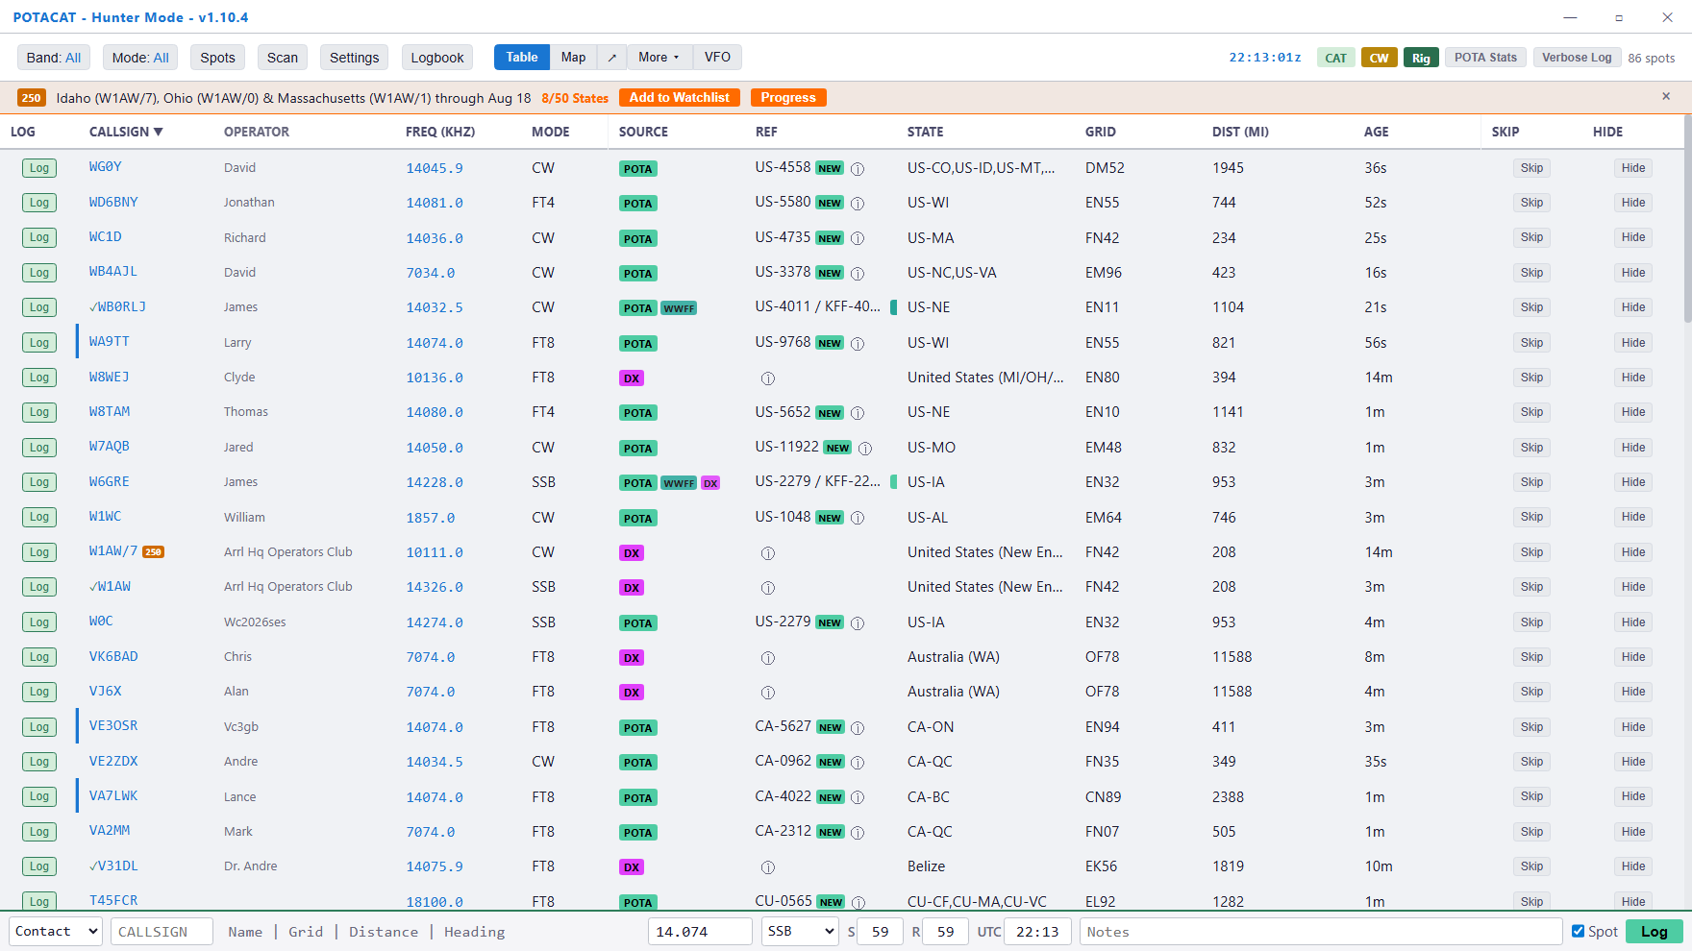
The Main View
Notes:
This is the "aha" slide. Pause on it and let them read.
Point out with the cursor, in this order:
1. The green POTA tags and the purple DX cluster tags — these are DIFFERENT
networks, merged into one list.
2. The park reference column with the green NEW badge — parks you have never
worked.
3. The AGE column — how fresh the spot is.
4. The distance, computed from YOUR grid square.
Then say the line at the bottom of the slide.

Slide 5
THE HONEST ANSWER
What it costs
The program: free
Open source, GPLv3. No trial, no nag screen, no unlock code.
No account needed
On your own home network everything works with no sign-up at all.
Runs on your Shack Computer
No extra hardware to buy. It runs on the computer already sitting next to your radio.
Windows, Mac, Linux
Intel and ARM. One download page, pick your machine.
Phone app: $9.99, once
ECHOCAT for iPhone and Android. POTACAT Cloud, for from-anywhere access, is a separate optional subscription.
Supported by hams
Active Discord, frequent updates, the author answers questions himself.
Notes:
Say the word "free" out loud. This crowd assumes a catch, and there isn't one.
Be straight about the only paid piece: POTACAT Cloud. Remote operating on your own
home network, or over Tailscale, costs nothing. Cloud is for the case where your
internet provider makes it impossible — we will come back to that at the end.

Slide 6
Setting up your radio
If you can CAT control your radio, POTACAT will work!

Slide 7
RADIO SETUP
Pick your lane
If you have... | Choose this | Notes
FlexRadio 6000/8000 | FlexRadio (SmartSDR) | Nothing else to install
Icom, Yaesu, Kenwood, most rigs | Other Rig (Hamlib) | 200+ models, built in
QRP Labs QMX/QDX, Elecraft | Serial CAT (Kenwood) | Straight USB cable
Elecraft K4, networked Icom | IP / Network | Over Ethernet or Wi-Fi
Already running flrig or a Pi | rigctld Network | Point it at flrig
Hamlib is bundled. There is nothing separate to download.
Notes:
The message of this slide is "your radio is on this list."
If someone shouts out a model, the answer is almost always yes. Tell them: when in
doubt, start with "Other Rig (Hamlib)" and search for your model.
Do NOT get pulled into a 10-minute serial-port debugging session in front of the
room. Offer to sit down with them afterward — that offer alone sells the program.

Slide 8
GETTING STARTED
When You First Launch POTACAT…
Your callsign
Used for logging, the DX cluster, and the Reverse Beacon Network.
Your grid square
So it can show you distance and beam heading to every spot.
Miles or kilometers
Your preference.
Your license class
So it can hide spots you are not licensed to work.
Press F11 any time to get this screen back.
Notes:
The license-class question is a bigger deal than it sounds. Technicians love it --
they stop chasing spots they cannot legally answer. Generals stop chasing the
Extra-only portion of the band.
Tell them: this takes about ninety seconds and then the program leaves you alone.

Slide 9
Band, Mode, and Spots
Three menus control everything you see on the screen.

Slide 10
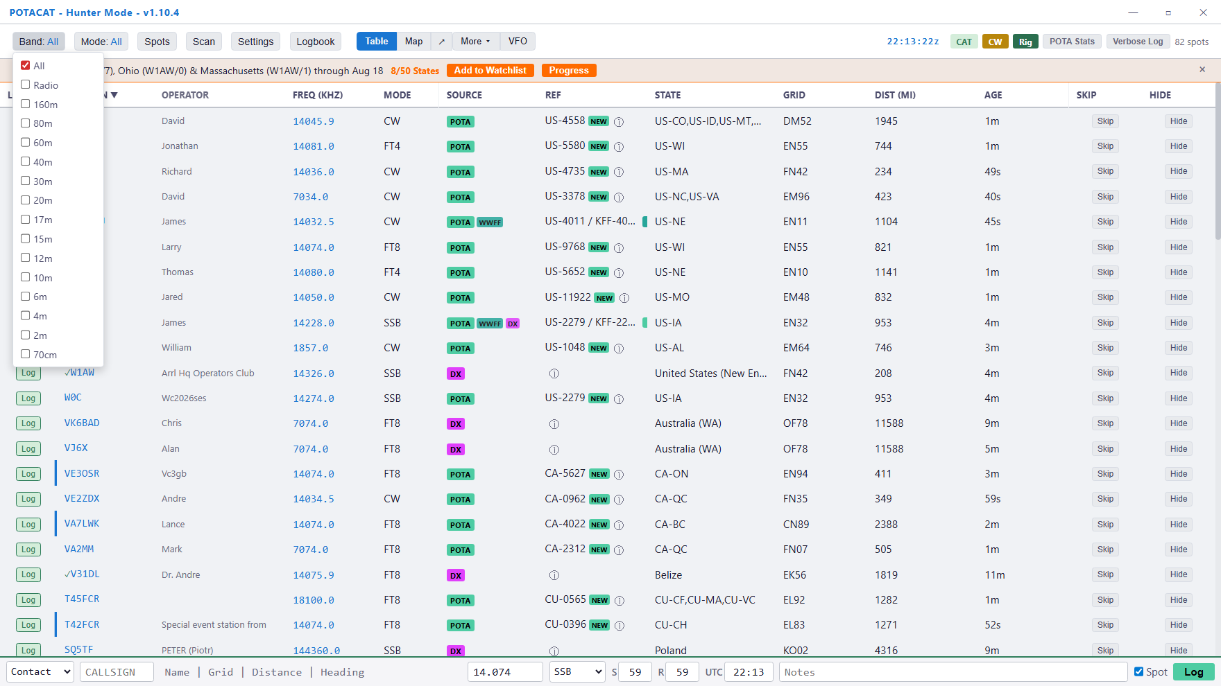
The Band menu
160 metres through 70 centimetres, or All.
Notes:
Simple slide, quick pass.
The practical tip: set the band before you sit down. If you are working 20 metres,
put it on 20 metres and the noise disappears from your screen.
Note the "Radio" option at the top — that follows whatever band your radio is
actually on, which is a nice touch once you trust it.

Slide 11
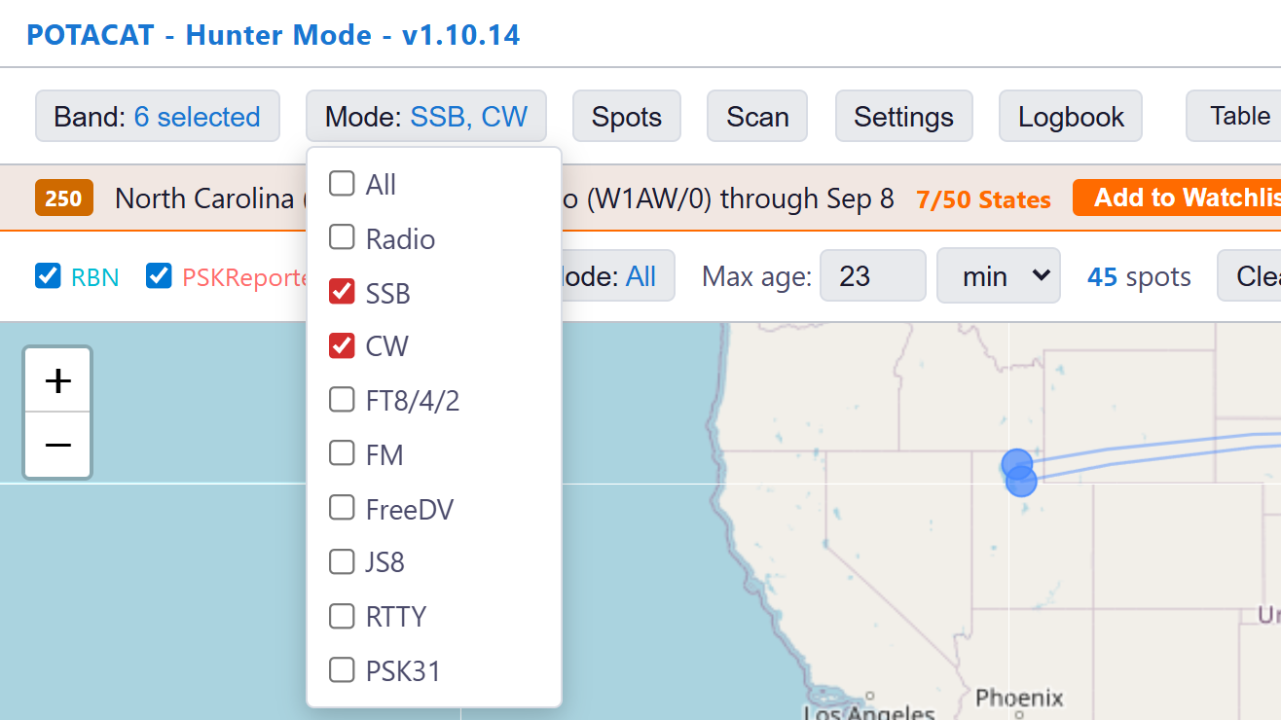
The Mode menu
CW, SSB, FT8/FT4/FT2, FM, FreeDV, JS8, RTTY, PSK31.
Notes:
The important part is not the filter — it is what happens when you click a spot.
POTACAT sets your RADIO's mode too. Click a CW spot and the rig goes to CW with the
right filter width. Click an SSB spot and it goes to the correct sideband for that
band. You never end up listening to a CW signal in wide SSB again.
Mention the CW offset setting: POTACAT can add your preferred offset automatically
so the tone lands where your ear likes it.

Slide 12
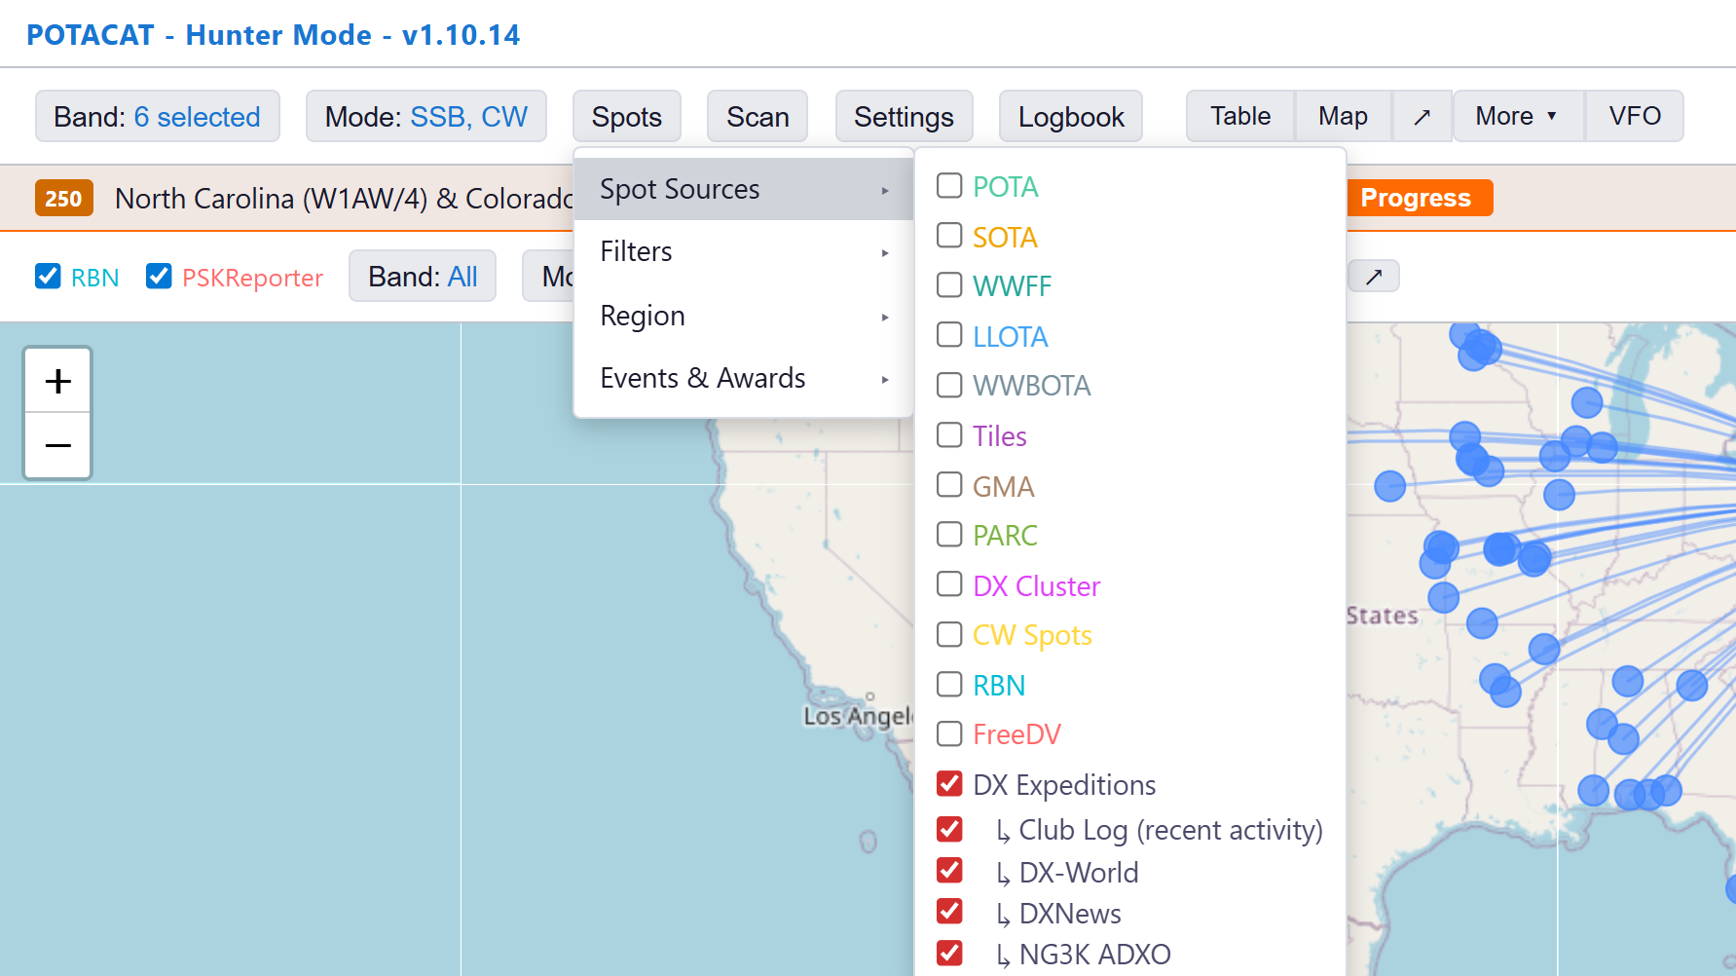
Where the spots come from
Turn on only what you chase. Everything is merged and de-duplicated into one list.
Notes:
Walk the list out loud: POTA. SOTA. WWFF — flora and fauna. LLOTA — lighthouses.
WWBOTA — bunkers. GMA — mountains. The DX cluster. The Reverse Beacon Network.
DXpeditions from Club Log.
Then the advice that actually matters for a new user:
START WITH POTA ONLY.
A first-timer who turns everything on gets a firehose and closes the program. Add
one source at a time as the screen starts to feel comfortable.

Slide 13
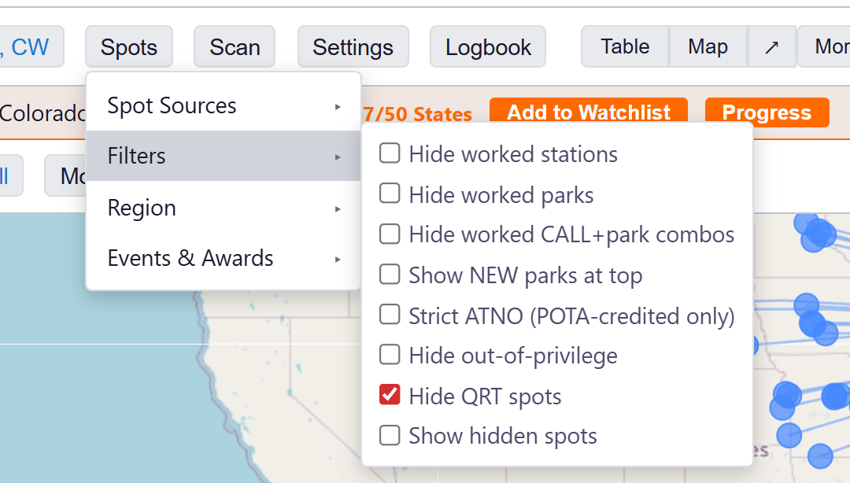
Filters that save time
Hide worked parks
Import your POTA CSV once. Parks you already have disappear.
Show NEW parks at top
Parks you have never worked float to the top with a green badge.
Hide out-of-privilege
Never chase a spot you cannot legally answer.
Watchlist
Type in a callsign, get a star and an alert when they show up anywhere.
Notes:
The watchlist is the sleeper feature in this whole program. Put your buddy's
callsign in there and POTACAT will tell you when he is on the air — on ANY of the
sources, not just POTA.
"Hide QRT spots" is on by default and quietly saves you from calling people who
already packed up.

Slide 14
Table, Map, and Scan
Two ways to look at the same truth — and one way to let the radio hunt.

Slide 15
Table view: the working list
Sort any column. Colour-coded by source..
Notes:
Point out the AGE column specifically. New users chase forty-five-minute-old spots
and then wonder why nobody comes back. If it says 25s, they are on the air right now.
Also point out: distance and beam heading are computed from YOUR grid, and you can
drag the column edges and hide columns you do not care about (right-click the header).

Slide 16
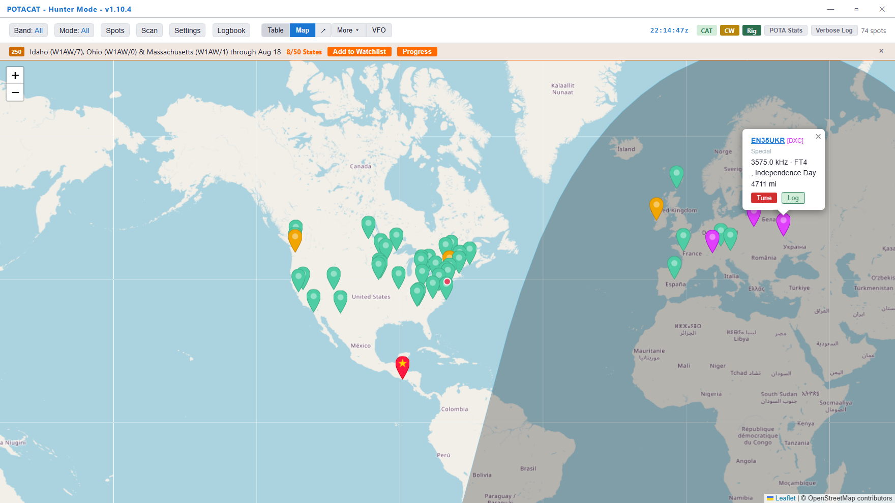
Map view: the picture
Every spot where it actually is, your home QTH, and the grey line moving across the map.
Notes:
The map sells the program to people who do not think in numbers. Let it sit on the
screen for a few seconds before you talk.
Point at the shaded area on the right — that is night. That is the grey line. Once
you can see it, you stop calling stations on the wrong side of the terminator and
wondering why they cannot hear you.
Green pins are POTA. Orange is SOTA. Purple is the DX cluster. Click any pin and you
get the callsign, frequency, distance, and a Tune button right in the balloon.

Slide 17
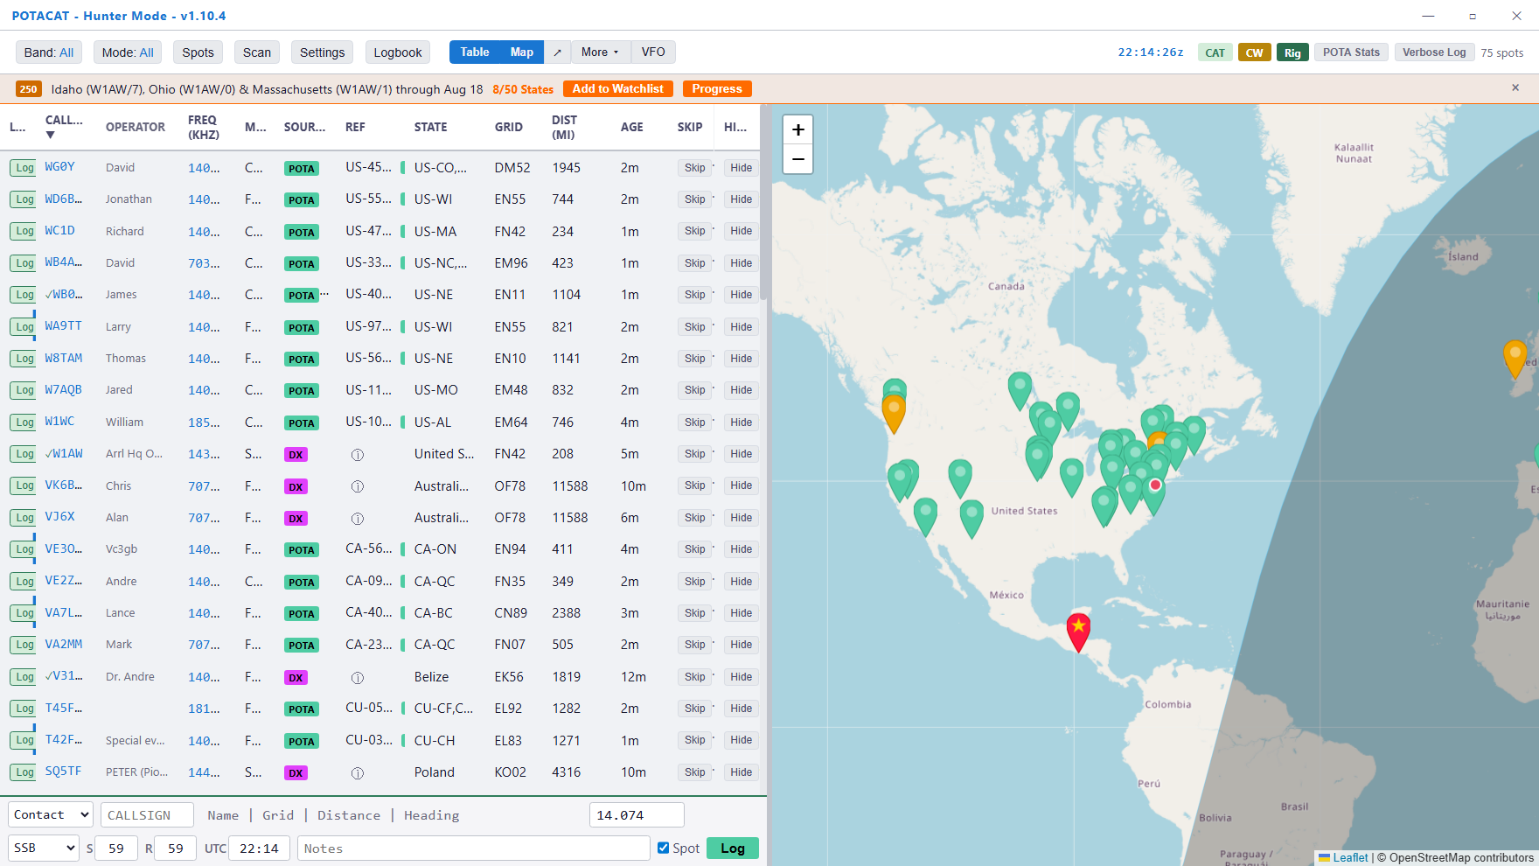
Both at once, or on a second screen
Press S for split view. Or pop the map, the logbook, or FT8 into their own windows.
Notes:
If they run two monitors, this is the slide that matters. The map, the logbook, the
FT8 window, and the VFO can all be torn off into separate windows and dragged to the
second screen. POTACAT remembers where you put them and reopens them there.

Slide 18
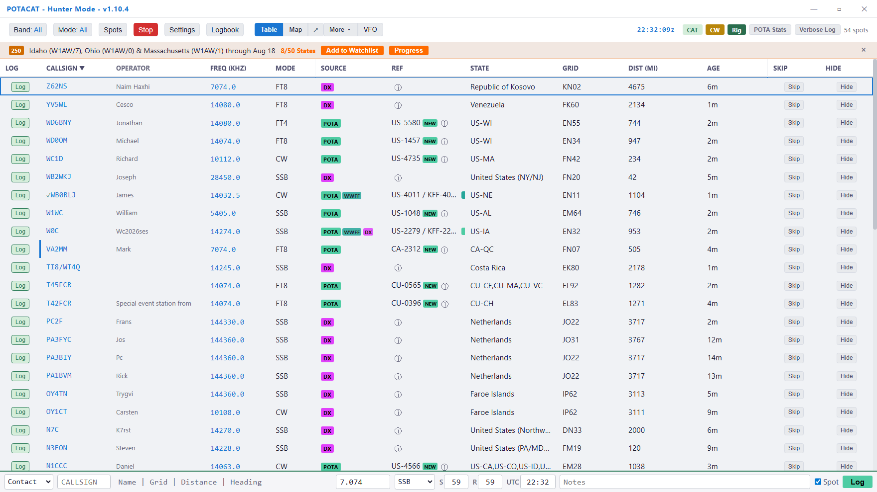
Scan: let the radio do the hunting
Press Space, or click Scan
POTACAT steps through every spot on your filtered list.
It pauses on each one
Seven seconds by default. Set it to whatever suits your ear.
Hear something? Press Space
Scan stops and the radio stays right there. Work them.
Mark a spot Skip
Scan passes it by next time around.
Notes:
This one always gets a reaction, because nobody expects it.
The pitch: "Pour a cup of coffee, sit back, and let the radio go find the pileups
for you."
Point at the highlighted row in the screenshot — that is the spot it is parked on
right now, and the frequency at the bottom of the window is where the radio actually
went.

Slide 19
The VFO, conditions, and propagation
A dial you can read across the room, and proof of where you are getting out.

Slide 20
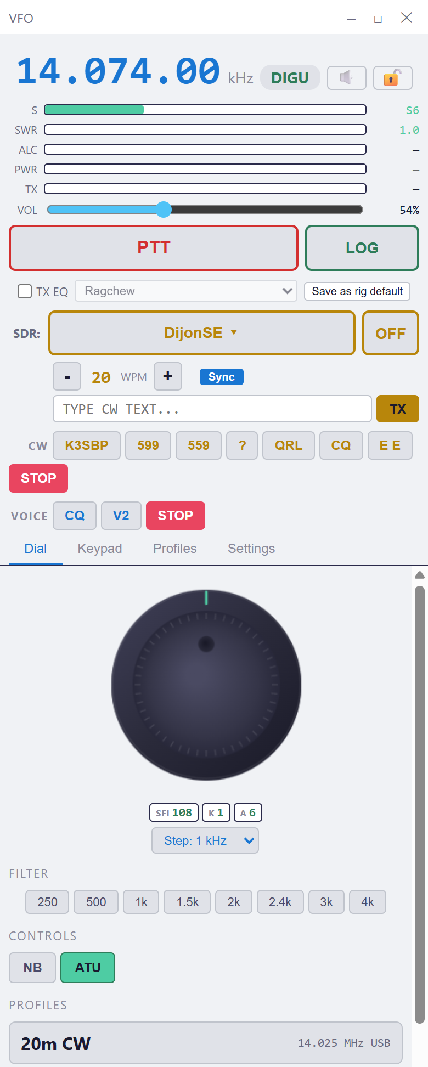
A dial that is not on the radio
Readable from across the room
The frequency in numbers you can see from the recliner.
Everything you actually reach for
Band, mode, filter width, power, S-meter, SWR, ATU, noise blanker.
Send CW from the keyboard
Type it, or hit a macro: CQ, your call, 599, QRL, 73.
Save VFO profiles
"20m CW", "40m CW" — one click puts you back where you like to sit.
The same window runs on your phone.
Notes:
For anyone whose radio lives in the basement or the garage, this is the "I can see
it from my chair" slide.
Note the PTT and LOG buttons at the top, and the CW macro row. That CW row is the
same one you get on the phone later in this talk — which is how somebody ends up
sending code from a park bench.

Slide 21
"Is my signal actually getting out?"
Notes:
Set this up as a genuine change in the hobby, because it is. Everyone in that room
spent decades with no way to answer this question except asking somebody.
Then: two networks do the listening. The Reverse Beacon Network hears your CW. PSK
Reporter hears your FT8 and other digital signals. POTACAT reads both.

Slide 22
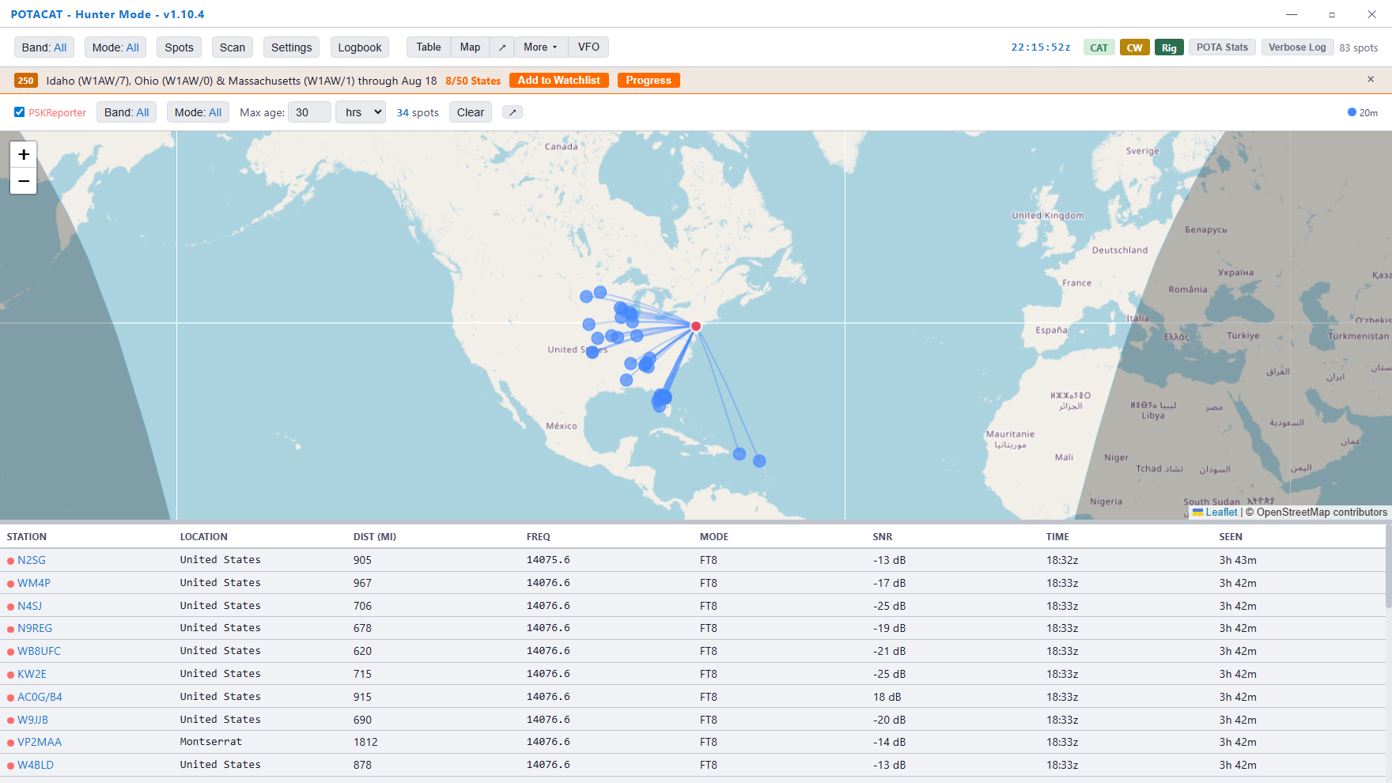
Proof of where you land
Every station that decoded you, on a map, with signal report and distance. This is one afternoon on 20 metres.
Notes:
Read a couple of lines off the table out loud — callsign, distance, signal report.
"That station in Montserrat, eighteen hundred miles, heard me at minus fourteen."
Then the use that sells it: change antennas, call again, and watch the map change.
That is antenna testing without needing a second operator on the other end.
Two sources feed this view:
- PSK Reporter, shown here, for FT8 and the digital modes
- RBN, the skimmer network, for your CW — same map, band-coloured dots, with
your keying speed and signal-to-noise
NOTE FOR THE PRESENTER: the RBN half of this map only fills in after you have
actually called CQ on CW. Call CQ for a minute before the meeting and it will be
populated when you get here.

Slide 23
Digital modes
FT8, JS8, WSPR, and the rest — built in, with no second program.

Slide 24
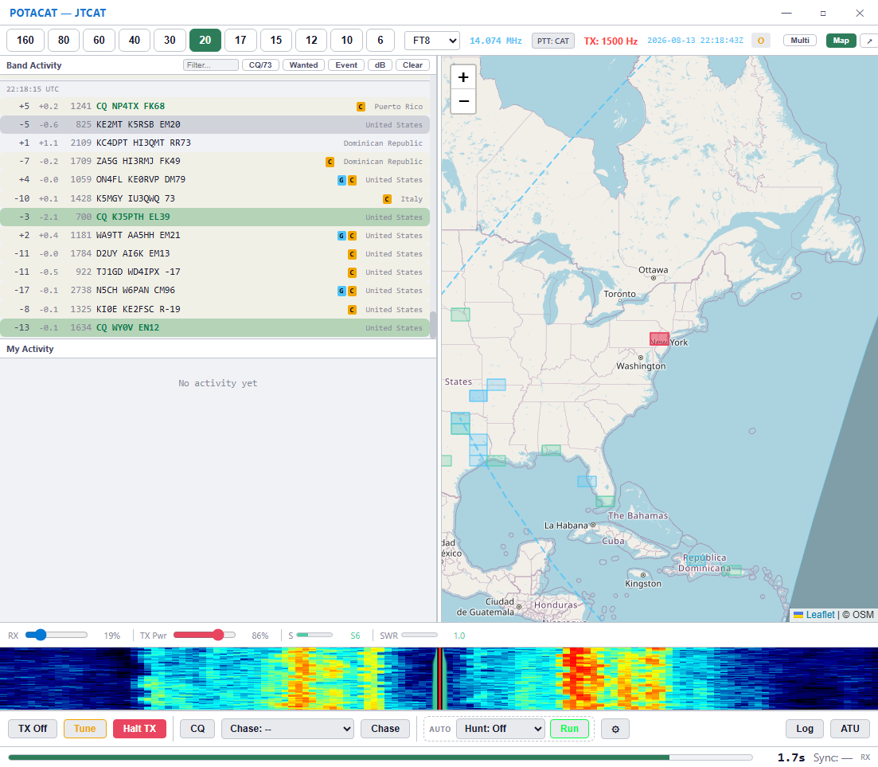
FT8 / FT4 / FT2
FT8, FT4 and FT2 are built in
No WSJT-X. No JTAlert. No virtual audio cable. No second program at all.
Notes:
For anyone who has ever fought WSJT-X audio routing, this is the biggest slide in
the deck. Say the words slowly:
"No virtual audio cable."
Let that land. Then walk the screen:
- Left: the decodes. Green rows are stations calling CQ.
- The flags and countries are filled in for you.
- Right: a map with the grid squares of everyone you are hearing.
- Bottom: the waterfall.
FT4 and FT2 work the same way.

Slide 25
FT8 SEQUENCING
Double-click, and it works the QSO
Double-click a station and POTACAT answers
It sends the report, sends 73, and logs the contact — the full sequence, the same one WSJT-X follows.
It hears stations a plain decoder misses
Weak and late-arriving signals get recovered, so marginal replies still complete.
Park activators get logged with the park
Work a park on FT8 and the reference goes into the log automatically.
You still choose who to work
It types for you. It does not decide for you.
Notes:
Do not oversell automation to this crowd — some of them are suspicious of it, and
rightly so. Frame it exactly as the last bullet says: it types for you, you decide
who to work.
If somebody asks about fully automatic operation: yes, that exists, it is hidden
behind an unlock, and it has an attended-operator timer built in because Part 97
expects a control operator to be present. Do not dwell on it.

Slide 26
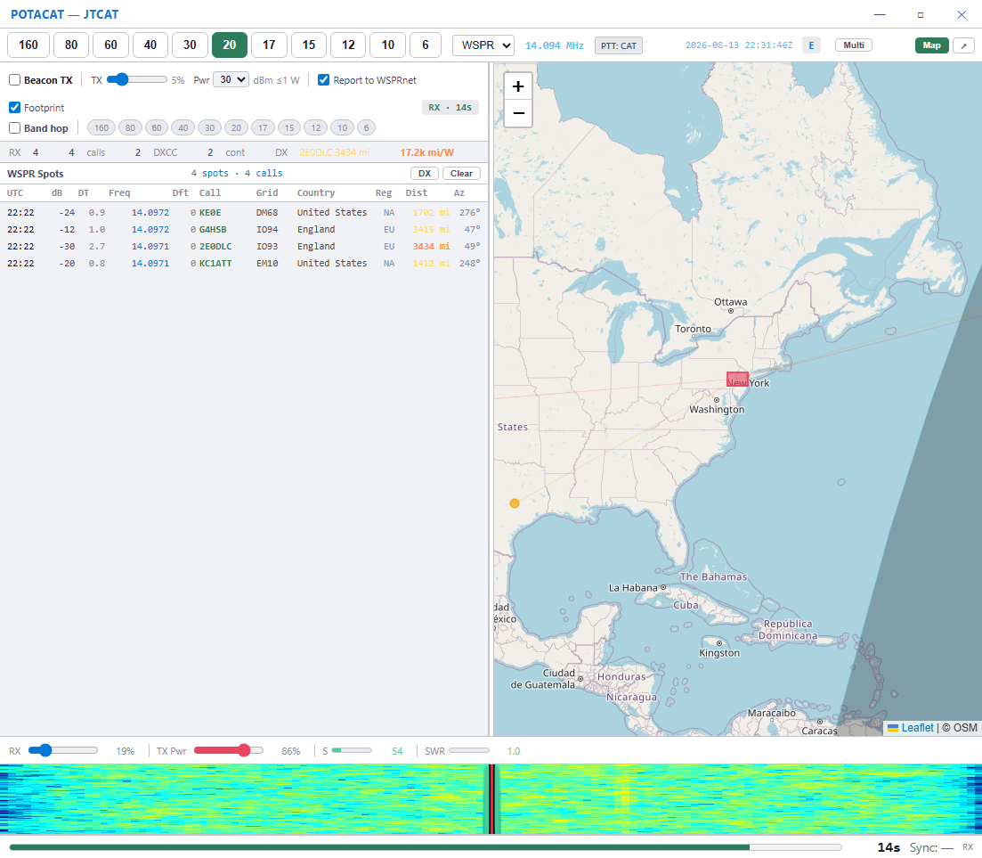
WSPR: your antenna’s report card
Under one watt, overnight
By morning you know exactly where your antenna plays.
It listens and it reports
Who heard you, how far, on which band — uploaded to WSPRnet for you.
Miles per watt
In this screenshot: England, 3,434 miles, at 17,200 miles per watt.
Band hopping
Let it walk the bands on its own and tell you which one is really open.
Notes:
Great slide for the antenna builders and the QRP crowd.
The pitch: "This is the cheapest antenna test in amateur radio, and it runs while
you sleep."
Emphasise how little power it uses — this is a propagation and antenna experiment,
not a contest. Under a watt gets across the Atlantic, as you can see here.

Slide 27
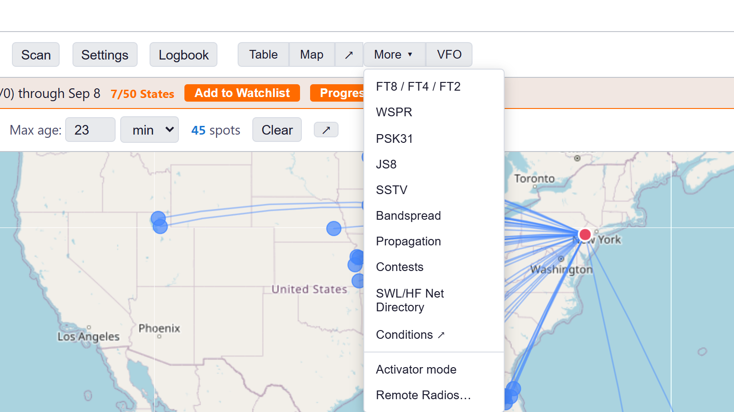
MORE MODES
And the rest of the digital shelf
JS8, PSK31, SSTV, FreeDV, and a CW keyer — all built in, no extra software.
Notes:
Quick pass, do not linger — this is a "and there is more in the box" slide.
JS8 — keyboard-to-keyboard chat, messaging, even APRS
PSK31 — the classic, with editable macros
SSTV — send and receive pictures
FreeDV — digital voice
CW — a real keyer with a paddle, or send from the keyboard
Bandspread and the SWL/HF Net directory are in there too — the net directory is
worth a mention if your club runs a net.

Slide 28
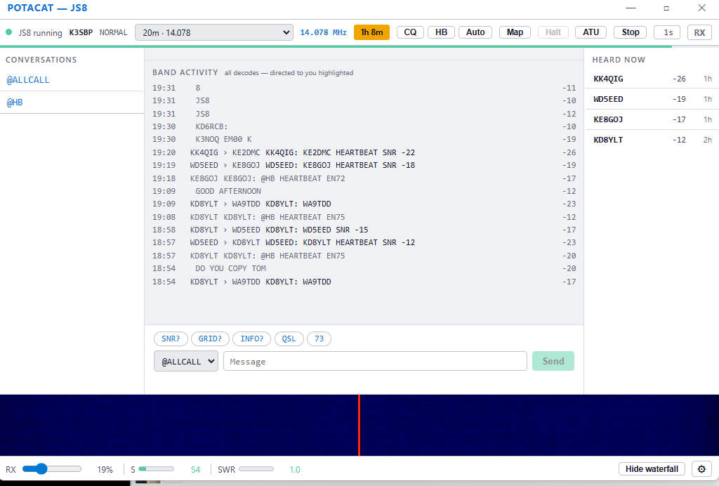
JS8 is built in too
Keyboard-to-keyboard text over HF. No JS8Call to install, no virtual audio cable.
Notes:
JS8 is the conversational cousin of FT8: same weak-signal robustness, but you type real messages to real people. POTACAT decodes and transmits it natively. Open it from More, then JS8, press Start.
Point out: heartbeats, directed messages, and the mailbox keep running while you are away from the desk.
Screenshot came from the other deck (light mode, your station). Recapture at full resolution if you want it sharper.

Slide 29
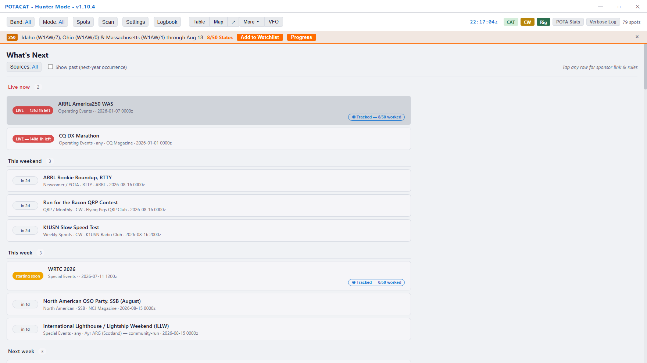
Know what is on this weekend
Live now, this weekend, this week
A running calendar of what is on the air right now and what is coming.
So 20 metres stops being a mystery
When the band is wall-to-wall, you know why before you blame your radio.
Chase them or avoid them
Either way, do not be surprised by them.
Tap any row for the sponsor and the rules.
Notes:
Half the room chases contests and half the room avoids them. Say that out loud --
it gets a laugh and it makes the point that this slide serves both groups.
Special events and operating events show up here too, which is how you find things
like the lighthouse weekend or a special-event station.

Slide 30
Logging
Log it once. It goes everywhere you already keep your log.

Slide 31
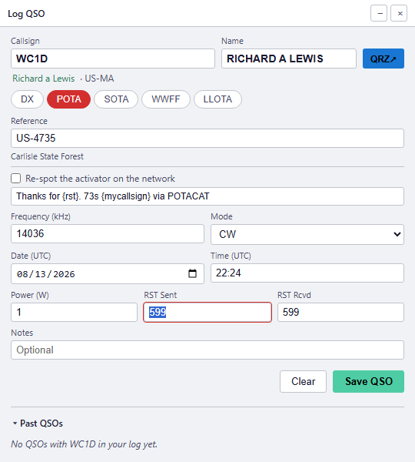
Log the contact without typing it
Click Log on any spot
Callsign, name, frequency, band, mode, date, time, and power are already in.
The park comes with it
Reference and park name, filled in from the spot.
The operator’s name comes from QRZ
So you can greet them properly before you log them.
You type the signal report. Press Enter.
That is the whole job.
Notes:
Point out that everything on this form except the signal report was filled in by the
program. That is the point of the slide.
The "Past QSOs" panel at the bottom tells you whether you have worked this station
before, and when — so you know if it is a dupe before you call.

Slide 32
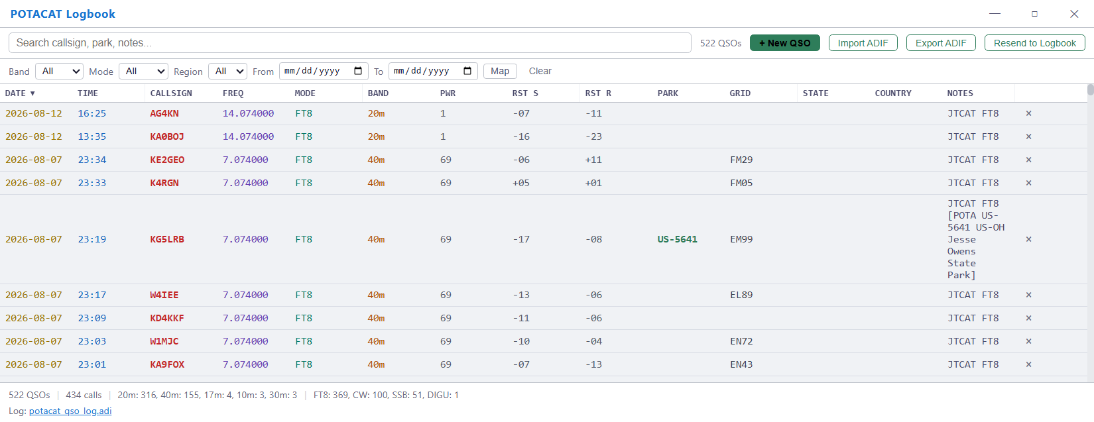
Your logbook, built in
Search it, sort it, fix a typo by clicking the cell, export ADIF any time. Press F2.
Notes:
The line that matters to this audience:
"Your log is a plain ADIF file on your own computer. It is yours. It is not locked
inside somebody's cloud service."
Show the footer: total QSOs, how many unique callsigns, the breakdown by band and by
mode. And it exports standard ADIF, so it uploads to LoTW, eQSL, Club Log, POTA, and
SOTA like any other log.

Slide 33
Log once. It goes everywhere.
Logbook of the World
Signs and uploads with TQSL. Pulls confirmations back.
Log4OM 2
DXLab DXKeeper
N3FJP
Ham Radio Deluxe
Logger32
HamRS
MacLoggerDX
Wavelog
World Radio League
Plus GridTracker and JTAlert, and ADIF export for eQSL, Club Log, POTA and SOTA.
Notes:
THIS IS THE SLIDE THAT DEFUSES THE ONLY REAL OBJECTION IN THE TALK.
People are loyal to their logging program, and they should be. So say it plainly:
"POTACAT is not trying to replace your logbook. As you log each contact, it hands
it straight to the program you already use."
It also works the other way: you can import your existing log — from any of these,
or any ADIF file — so POTACAT knows which parks you have already worked and the
NEW badges are accurate from day one.

Slide 34
ECHOCAT – Remote Your Radio
Your whole station, in your pocket.

Slide 35
THINK OF IT LIKE A TV
ECHOCAT is the remote control for your shack
button presses
PTT
the picture and the audio
The TV is the brains.
POTACAT on your shack computer does all the work.
The remote just presses buttons.
That is ECHOCAT, on your phone.
Your phone does not run the radio. Your shack computer does. The phone just presses the buttons.
Notes:
The whole ECHOCAT idea in one picture. Point at the TV: that is the shack computer running POTACAT, connected to the radio, doing all the work. Point at the remote: that is your phone. It only sends button presses and gets the picture and audio back.
So nothing heavy runs on the phone, it works on any old phone or browser, and if the phone drops off the shack keeps running.

Slide 36
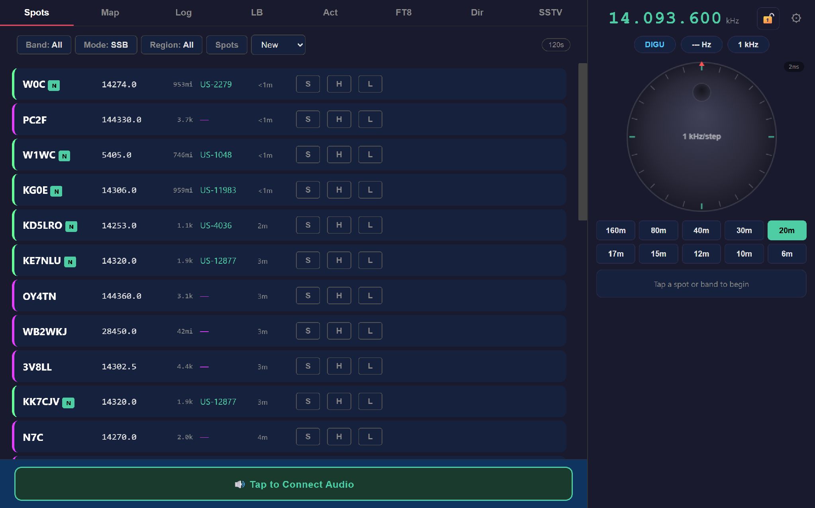
ECHOCAT WEB
ECHOCAT in a web browser
Open a browser. That is the entire installation. Laptop, iPad, hotel computer, the machine at work.
Notes:
Walk the screen: the spot list on the left, exactly the spots you saw earlier, with
the same park references and NEW badges. On the right, the VFO, the tuning dial, and
the band buttons. Across the top: Map, Log, Logbook, Activator, FT8, Directory, SSTV.
"Tap to Connect Audio" at the bottom is the one button that turns on receive audio
and your microphone.
Nothing was installed to make this work. It is served by the copy of POTACAT running
at the radio.

Slide 37
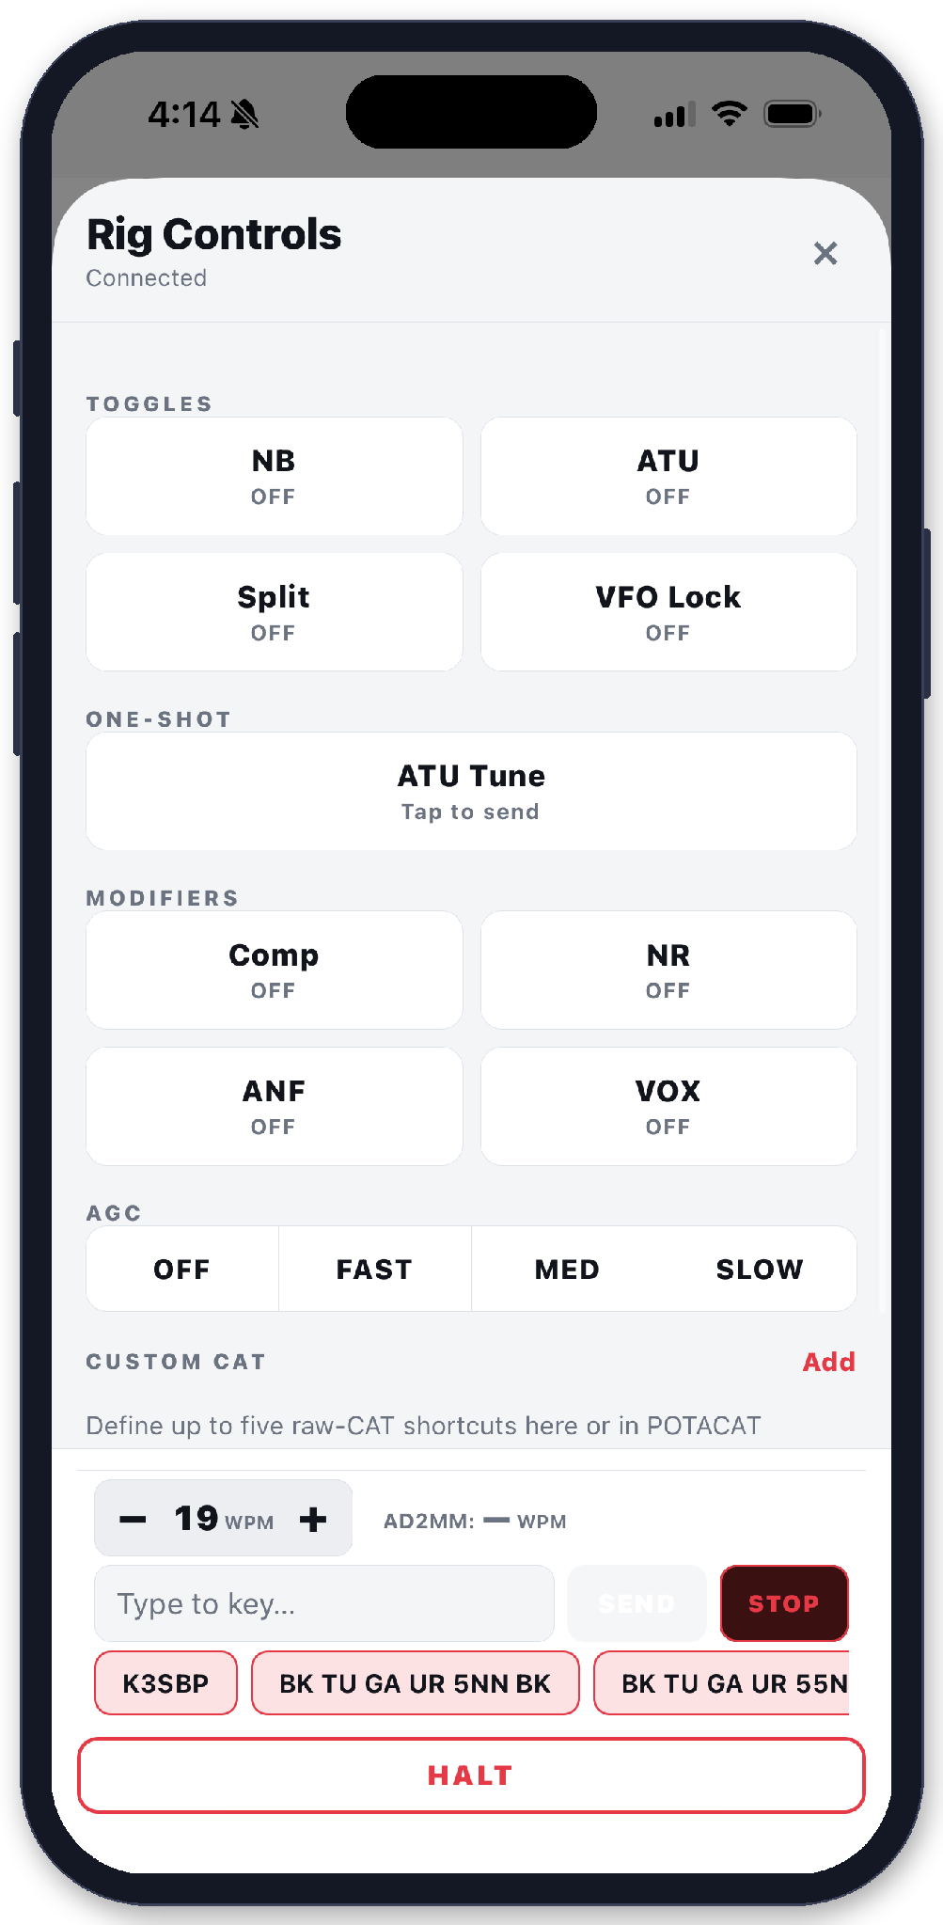
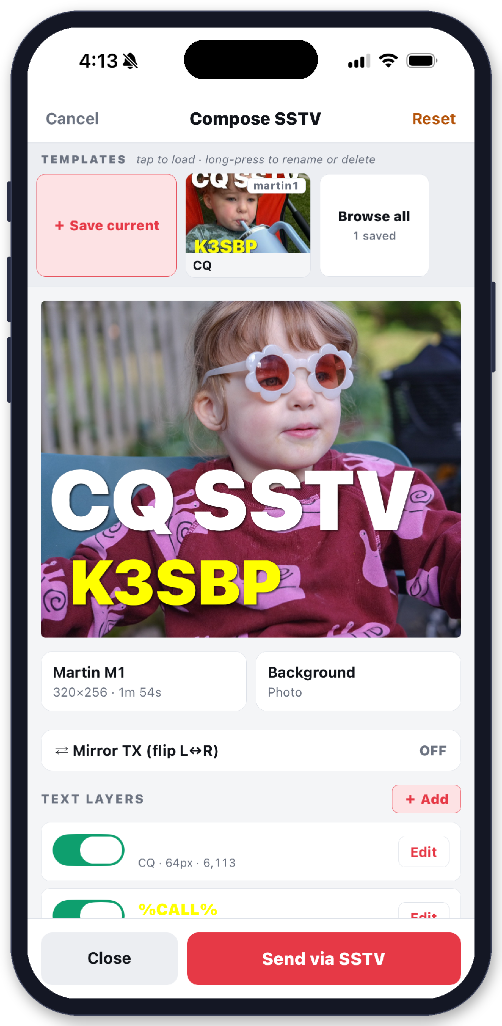
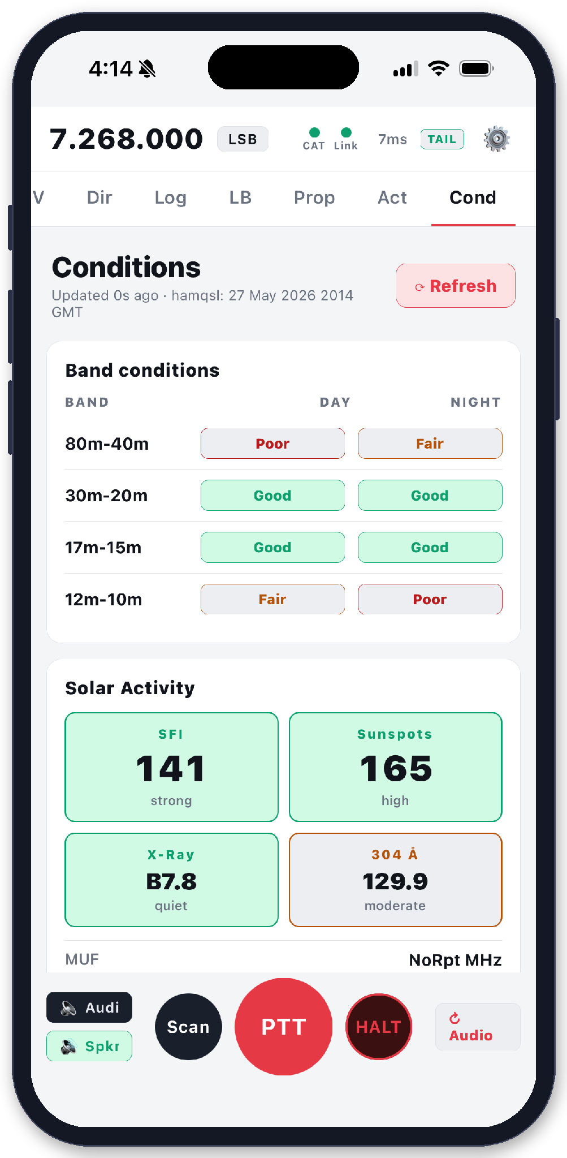
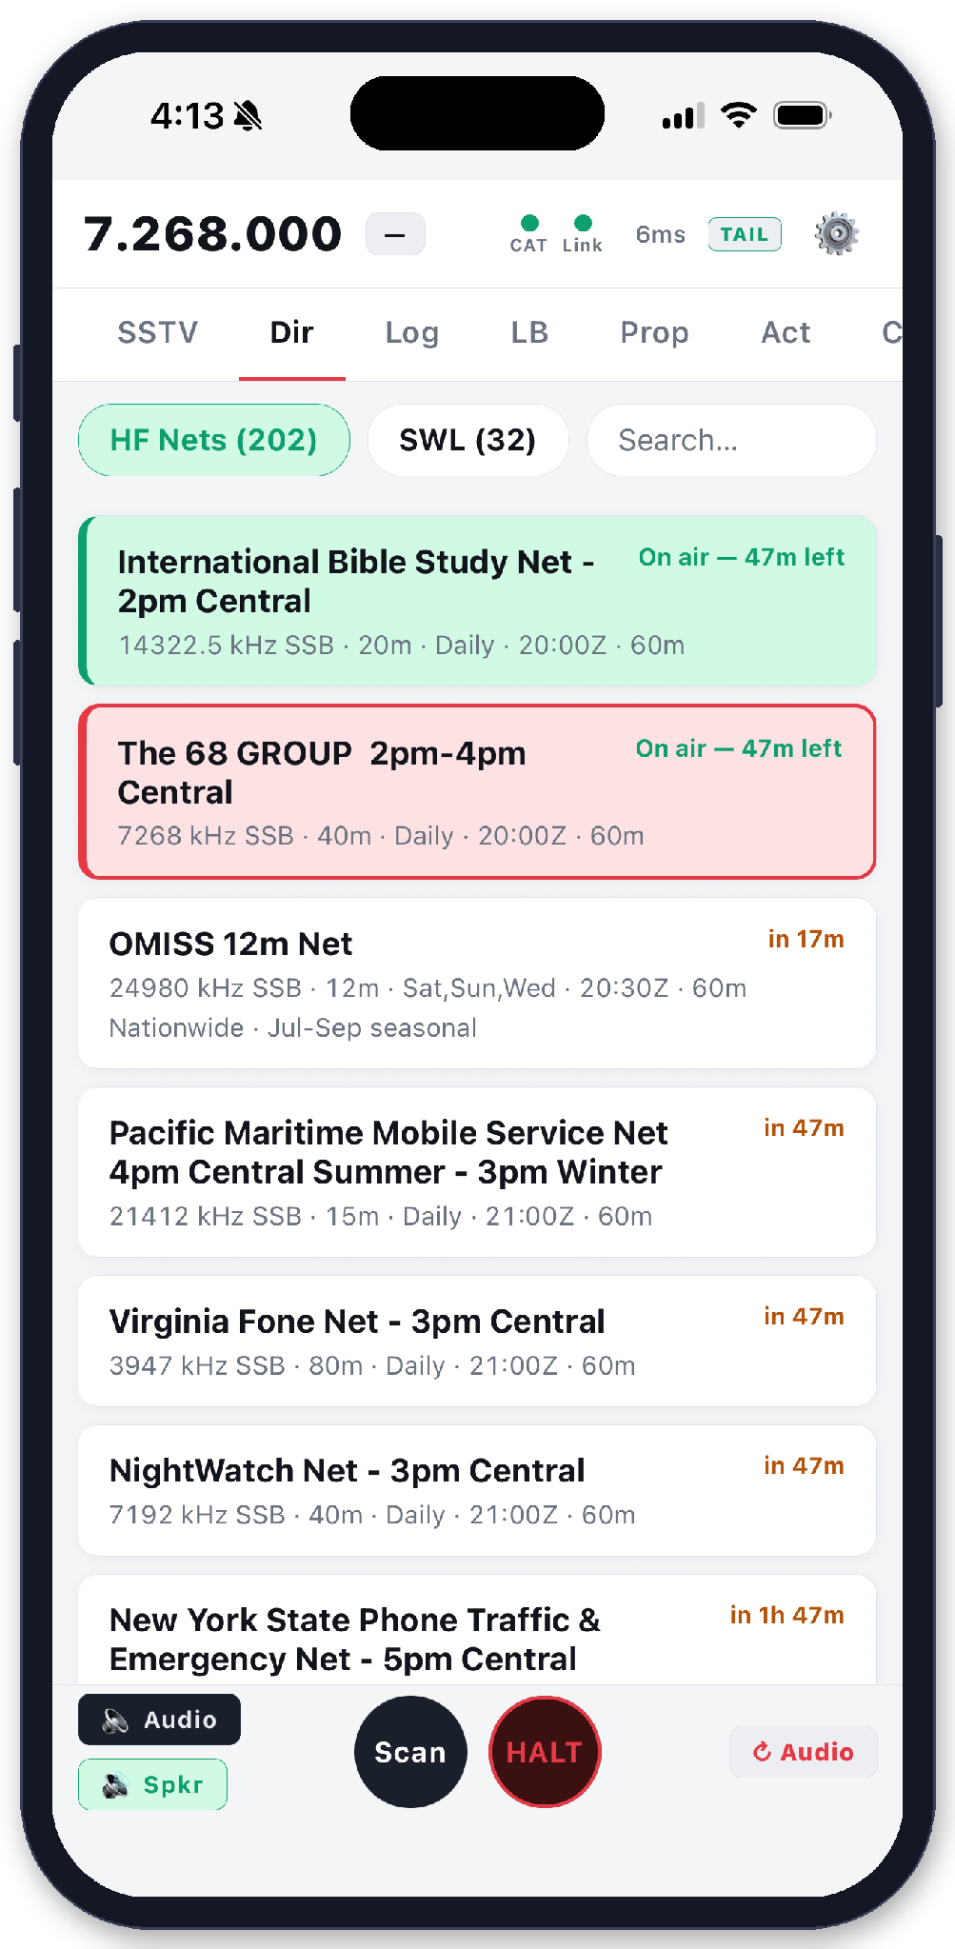
THE APP
ECHOCAT for iPhone and Android
$9.99
One purchase. No subscription to use it at home.
Search ECHOCAT on the App Store or Google Play.
Remote SSB, CW, FT8 and SSTV
Audio both ways, push-to-talk, CW macros or a MIDI paddle, and one-click logging.
The whole rig in your hand
ATU, noise blanker, split, VOX, AGC, and your own custom CAT shortcuts.
Rig controls
SSTV
Conditions
Nets and SWL
Spots, map, nets, conditions
Plus a KiwiSDR or WebSDR for listening when the shack rig is busy.
POTACAT Cloud, for from-anywhere access, is separate: $4.99 a month or $49.99 a year. At home you do not need it.
Notes:
This is the paid piece, and it is worth saying the number out loud: $9.99, once, on both stores. Everything on the left is in that price. Walk the four phones: rig controls (the buttons you actually reach for), SSTV (snap a photo, bounce it off the ionosphere), conditions, and the net directory for the long drive.
Then the honest line at the bottom: POTACAT Cloud is a separate subscription and only matters when you are away from your own network. Nobody in the room needs it to try the app tonight.

Slide 38
CAPABILITIES
What you can actually do from your phone
Listen
Real receive audio from the radio, not a recording.
Talk
Push to talk with the phone’s microphone.
Tune
VFO, band, mode, filter width, ATU, noise blanker.
Send CW
From macros or typed from the keyboard.
Work FT8
Decodes and complete contacts, from the phone.
Log it
Straight into your logbook back at the house.
Watch the waterfall
See the band, not just hear it.
Hand over the rig
Guest Pass gives another operator temporary access.
Shut it down
Rig on, rig off, from wherever you are.
Notes:
Run down these quickly — the list itself is the point. Most of the room assumes
"remote" means "I can see the frequency." It does not. It means you can work the
contact and log it.
Guest Pass is worth a beat: you can hand your radio to another operator for a set
time without giving away your credentials. Good for an Elmer letting a new ham try
HF, or covering a net while you are away.

Slide 39
Getting started
Five minutes tonight.

Slide 40
SUPPORT
Help, and where to find it
potacat.com
Download, documentation, and the user guide.
The Discord
potacat.com/discord — the community and the author, daily. This is the fastest help you will get anywhere.
GitHub
Bug reports and feature requests. They genuinely get read.
Written by Casey Stanton, K3SBP
Free and open source. If it earns its keep, there is a tip jar on the site.
Notes:
Push the Discord hard. A new user who joins it sticks around, because when they get
stuck somebody answers within the hour — often the author.
Then open the floor. The most common questions are on the next slide, with answers,
so you can flip to it if you need a prompt.

Slide 41
Q & A
Answers to common questions
"Will it work with my radio?"
Almost certainly. 200+ models through Hamlib, which is built in. Flex, Icom, Yaesu, Kenwood, Elecraft, QRP Labs all work.
"Do I have to give up my logbook?"
No. It feeds Log4OM, DXKeeper, N3FJP, HRD, Logger32, HamRS, MacLoggerDX, Wavelog and World Radio League as you log.
"Is it really free?"
POTACAT is. ECHOCAT for your phone is $9.99, one time. POTACAT Cloud, the from-anywhere option, is a subscription. Remote on your own network needs neither.
"Does it run on a Mac?"
Yes. Windows, Mac, Linux, and Raspberry Pi.
"Is remote transmitting legal?"
Yes, under the same rules that always applied — you are the control operator and you are responsible. There are transmit timers and safety cut-outs built in.
"What if my internet drops mid-transmission?"
The radio unkeys. There is a failsafe timer that drops transmit if the connection is lost.
Notes:
Keep this slide up during questions — it doubles as your cheat sheet.
One more that comes up and is not on the slide: "I don't do POTA." Neither do a lot
of users. The DX cluster, RBN, propagation maps, FT8, WSPR, logging, conditions and
remote control have nothing to do with parks.

Slide 42
Demo
Notes:
Leave this up during the rest of Q&A.
If you can, stay afterward and sit down with anyone who wants help connecting their
radio. One successful setup at the meeting turns into three more members running it
by next month.

Slide 43
Questions
Notes:
Leave this up during the rest of Q&A.
If you can, stay afterward and sit down with anyone who wants help connecting their
radio. One successful setup at the meeting turns into three more members running it
by next month.

Slide 44
Thank you
potacat.com | potacat.com/discord
Questions?
Notes:
Leave this up during the rest of Q&A.
If you can, stay afterward and sit down with anyone who wants help connecting their
radio. One successful setup at the meeting turns into three more members running it
by next month.

