Slide 1
M0 PWS
Construction Projects

Slide 2
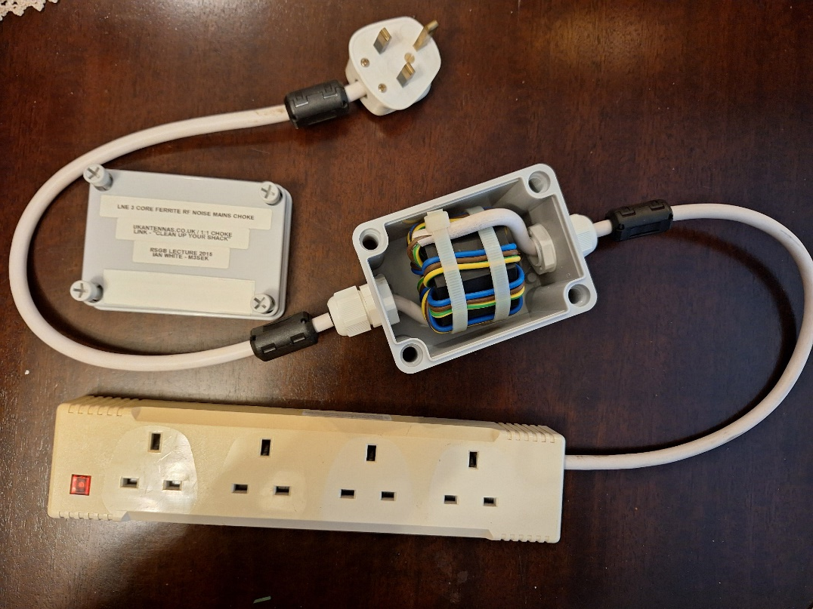
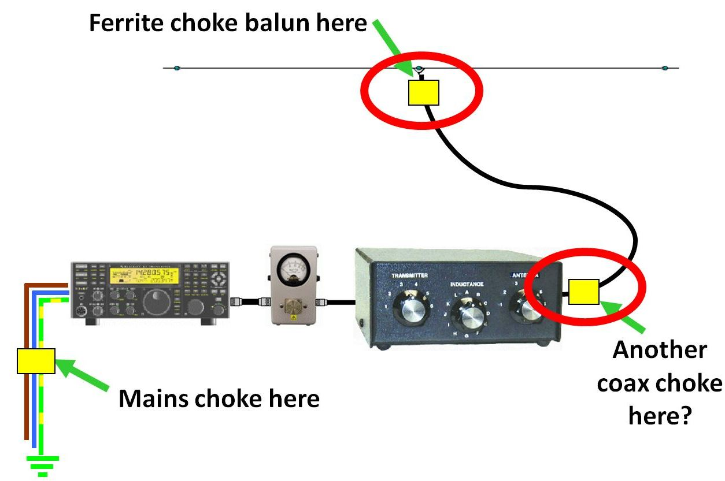
GM3SEK Live Neutral Earth MAINS CHOKE 2015 RSGB LECTURE https://www.youtube.com/watch?v=LSL1h6MJbaI
Large Fair-Rite core 0431177081
NB. Works both ways RF Interference in and out of the shack.

Slide 3
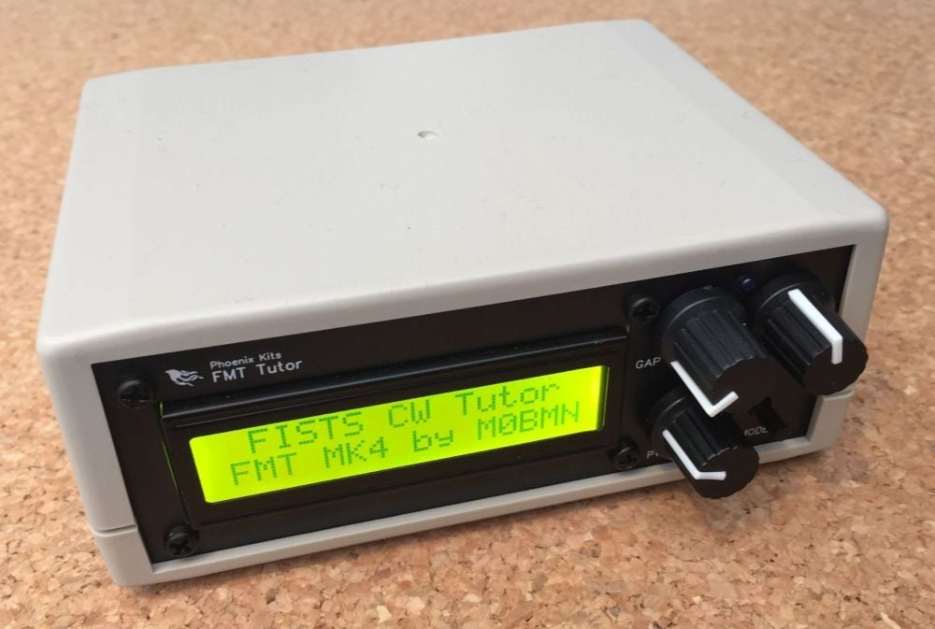
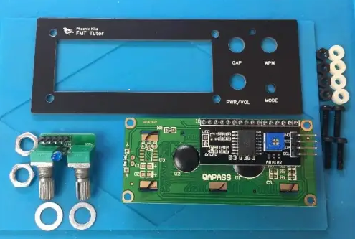
FMT Morse Tutor, Koch Trainer, Practice Oscillator & More
Easy to build but powerful Morse tutor.
This is available as a Fully Built Unit or as a Full Kit with case
New '4.1g' version as of 1/1/23 (now with built in Keyer option!)
The Koch Method is a method of character introduction that focuses on learning code as acoustic shapes.
Koch Lesson Characters
1 K,M
2 K,M,R
3 K,M,R,S
4 K,M,R,S,U
5 K,M,R,S,U,A
6 K,M,R,S,U,A,P
7 K,M,R,S,U,A,P,T
8 K,M,R,S,U,A,P,T,L
9 K,M,R,S,U,A,P,T,L,O
10 K,M,R,S,U,A,P,T,L,O,W
11 K,M,R,S,U,A,P,T,L,O,W,I
12 K,M,R,S,U,A,P,T,L,O,W,I,’ . ’
13 K,M,R,S,U,A,P,T,L,O,W,I,’ . ‘,N
14 K,M,R,S,U,A,P,T,L,O,W,I,’ . ‘,N,J
15 K,M,R,S,U,A,P,T,L,O,W,I,’ . ‘,N,J,E
16 K,M,R,S,U,A,P,T,L,O,W,I,’ . ‘,N,J,E,F
17 K,M,R,S,U,A,P,T,L,O,W,I,’ . ‘,N,J,E,F,0
18 K,M,R,S,U,A,P,T,L,O,W,I,’ . ‘,N,J,E,F,0,Y
19 K,M,R,S,U,A,P,T,L,O,W,I,’ . ‘,N,J,E,F,0,Y,’ , ‘
20 K,M,R,S,U,A,P,T,L,O,W,I,’ . ‘,N,J,E,F,0,Y,’ , ‘,V
21 K,M,R,S,U,A,P,T,L,O,W,I,’ . ‘,N,J,E,F,0,Y,’ , ‘,V,G
22 K,M,R,S,U,A,P,T,L,O,W,I,’ . ‘,N,J,E,F,0,Y,’ , ‘,V,G,5
23 K,M,R,S,U,A,P,T,L,O,W,I,’ . ‘,N,J,E,F,0,Y,’ , ‘,V,G,5, /
24 K,M,R,S,U,A,P,T,L,O,W,I,’ . ‘,N,J,E,F,0,Y,’ , ‘,V,G,5 ,/,Q
25 K,M,R,S,U,A,P,T,L,O,W,I,’ . ‘,N,J,E,F,0,Y,’ , ‘,V,G, 5/,Q,9
26 K,M,R,S,U,A,P,T,L,O,W,I,’ . ‘,N,J,E,F,0,Y,’ , ‘,V,G, 5,/,Q,9,Z
27 K,M,R,S,U,A,P,T,L,O,W,I,’ . ‘,N,J,E,F,0,Y,’ , ‘,V,G, 5,/,Q,9,Z,H
28 K,M,R,S,U,A,P,T,L,O,W,I,’ . ‘,N,J,E,F,0,Y,’ , ‘,V,G, 5,/,Q,9,Z,H,3
29 K,M,R,S,U,A,P,T,L,O,W,I,’ . ‘,N,J,E,F,0,Y,’ , ‘,V,G,5,/,Q,9,Z,H,3,8
30 K,M,R,S,U,A,P,T,L,O,W,I,’ . ‘,N,J,E,F,0,Y,’ , ‘,V,G,5,/,Q,9,Z,H,3,8,B
31 K,M,R,S,U,A,P,T,L,O,W,I,’ . ‘,N,J,E,F,0,Y,’ , ‘,V,G, 5,/,Q,9,Z,H,3,8,B,?
32 K,M,R,S,U,A,P,T,L,O,W,I,’ . ‘,N,J,E,F,0,Y,’ , ‘,V,G, 5,/,Q,9,Z,H,3,8,B,?,4
33 K,M,R,S,U,A,P,T,L,O,W,I,’ . ‘,N,J,E,F,0,Y,’ , ‘,V,G, 5,/,Q,9,Z,H,3,8,B,?,4,2
34 K,M,R,S,U,A,P,T,L,O,W,I,’ . ‘,N,J,E,F,0,Y,’ , ‘,V,G, 5,/,Q,9,Z,H,3,8,B,?,4,2,7
35 K,M,R,S,U,A,P,T,L,O,W,I,’ . ‘,N,J,E,F,0,Y,’ , ‘,V,G, 5,/,Q,9,Z,H,3,8,B,?,4,2,7,C
36 K,M,R,S,U,A,P,T,L,O,W,I,’ . ‘,N,J,E,F,0,Y,’ , ‘,V,G, 5,/,Q,9,Z,H,3,8,B,?,4,2,7,C,1
37 K,M,R,S,U,A,P,T,L,O,W,I,’ . ‘,N,J,E,F,0,Y,’ , ‘,V,G, 5,/,Q,9,Z,H,3,8,B,?,4,2,7,C,1,D
38 K,M,R,S,U,A,P,T,L,O,W,I,’ . ‘,N,J,E,F,0,Y,’ , ‘,V,G, 5,/,Q,9,Z,H,3,8,B,?,4,2,7,C,1,D,6
39 K,M,R,S,U,A,P,T,L,O,W,I,’ . ‘,N,J,E,F,0,Y,’ , ‘,V,G, 5,/,Q,9,Z,H,3,8,B,?,4,2,7,C,1,D,6,X
The new 'g' version adds the option of using the FMT as a basic keyer with a radio, also a simple AF signal generator so it can be used for testing other homebrew projects.
Has an interesting Historic mode called POW Tap Code.

Slide 4
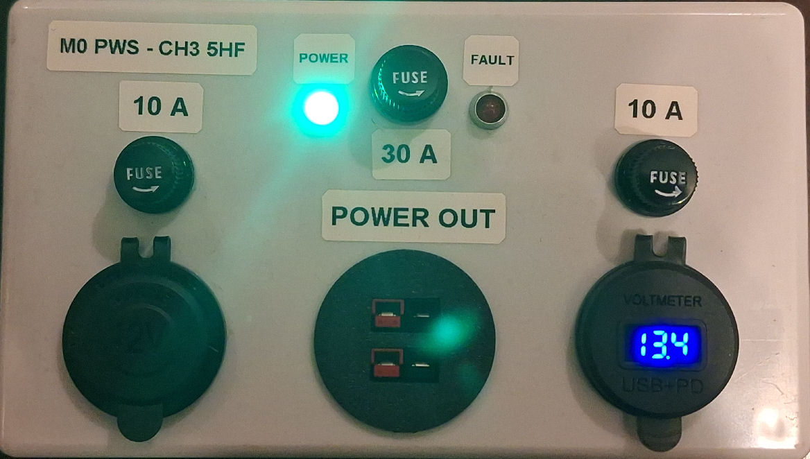
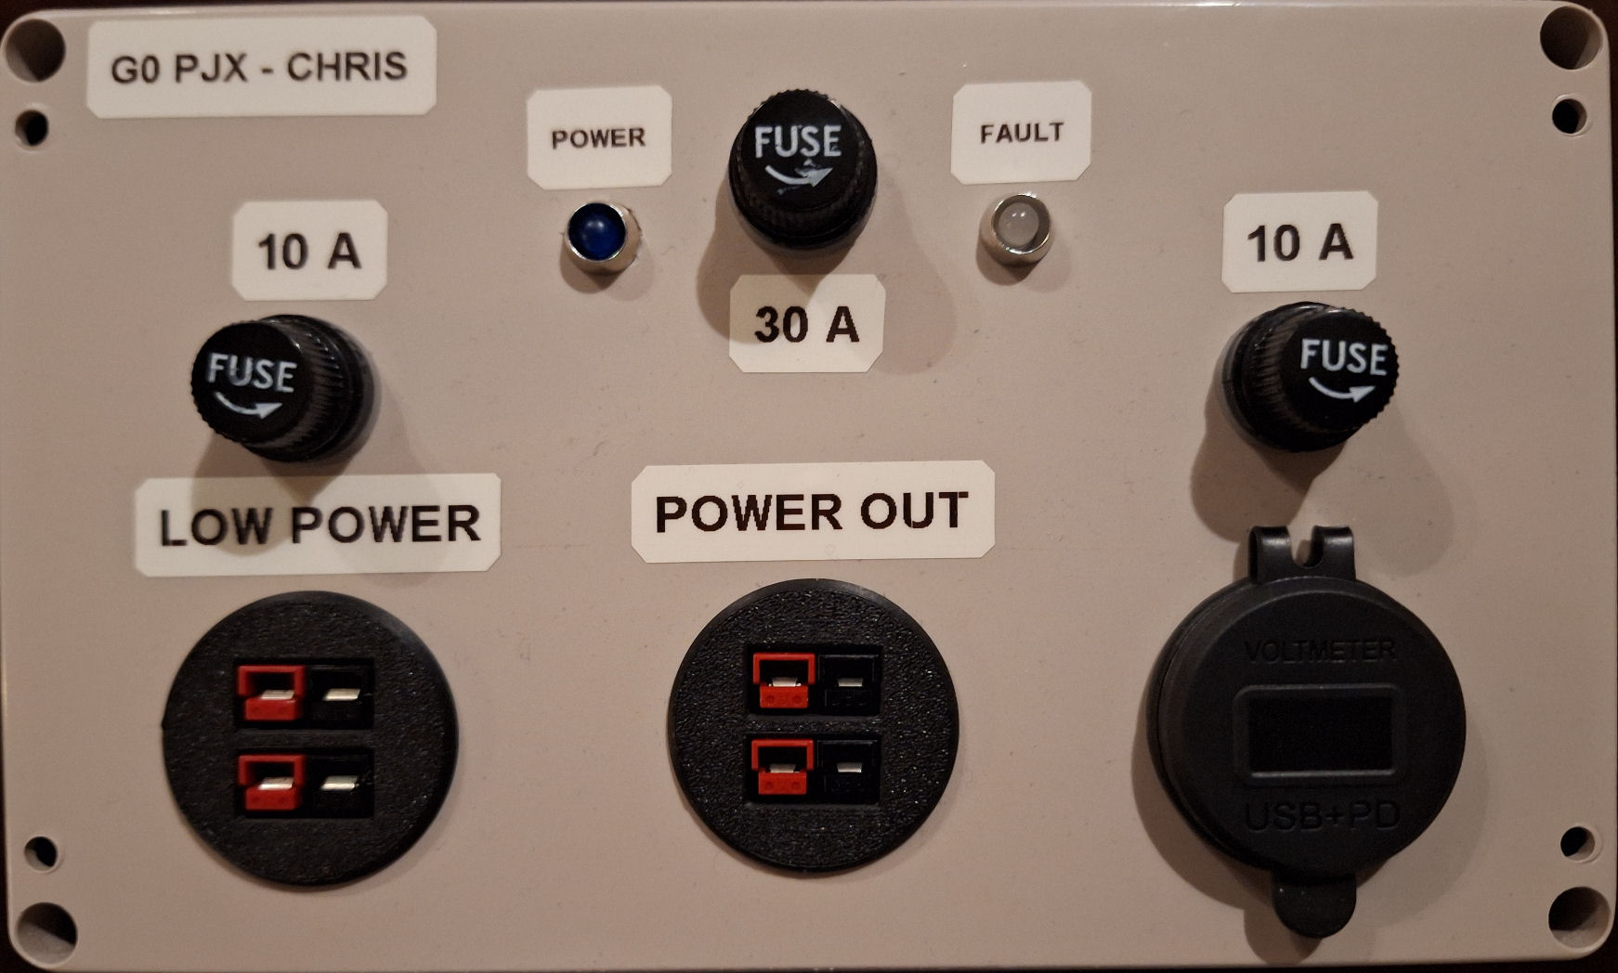
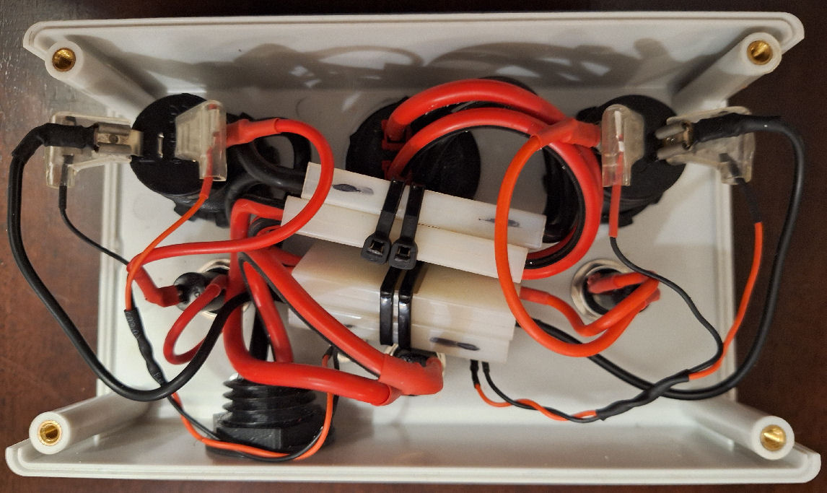
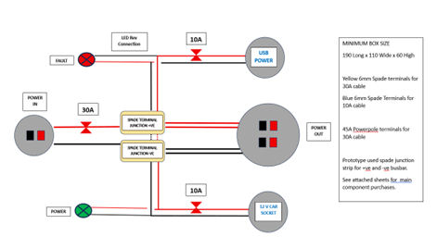
MOBILE POWER DISTRIBUTION ENCLOSURES
Designed and constructed by M0 PWS
< LEFT MOBILE PSU
Mk 1 design for M0 PWS
Lit Car Socket
2 x 30A Powerpole sockets
USB A & C Adapter & Voltmeter
RIGHT MOBILE PSU >
Mk2 design for G0 PJX
2 x 10A Powerpole sockets
2 x 30A Powerpole sockets
USB A & C adapter & Voltmeter
Both fused & with reverse polarity warning

