Slide 1
Learning Morse
(Doo-dits for beginners)
GW4OKT November 2024

Slide 2
Don’t be shy…
Stop me at any time if you have a question !

Slide 3
CW= Continuous Waves of radio energy, turned on and off to make Morse code.

Slide 4
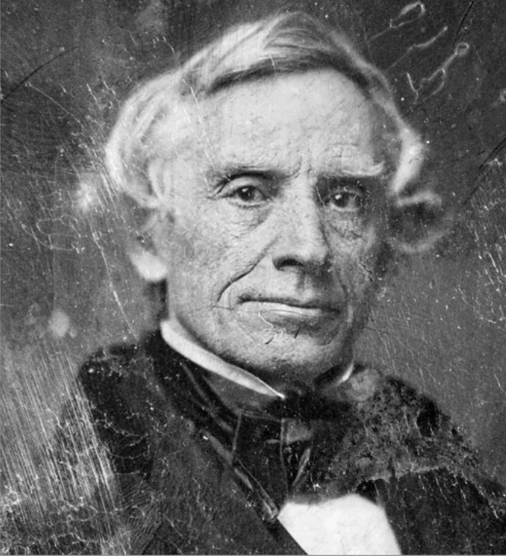
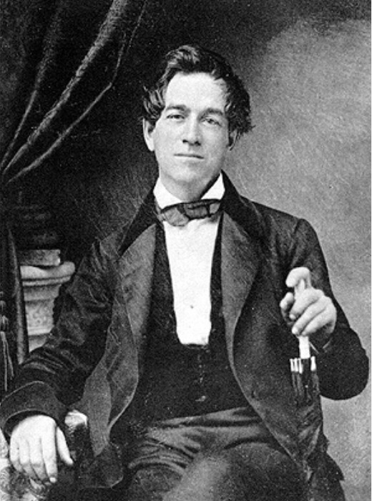
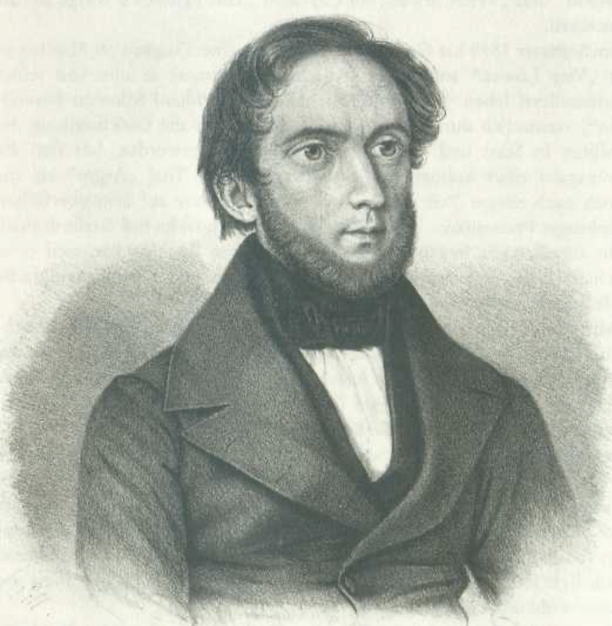
Morse invented the telegraph…..
Vail invented telegraphers…………
Gerke invented our code……………

Slide 5
Perfect timing for Samuel Morse
Faraday discovers electromagnetic induction 1831
Induction coil invented 1836
Daniell Cell invented 1836
Grove Cell invented 1839
Morse telegraphy 1838
First public demo 1844

Slide 6
First attempt 1938 (ish)
Morse initially used numbers to represent letters
Points on graph paper, 26 points = Z !
Vail developed the first alphabet system using dot and line?

Slide 7
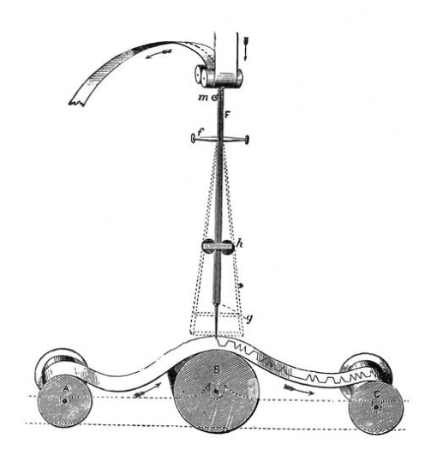
Morse register

Slide 8
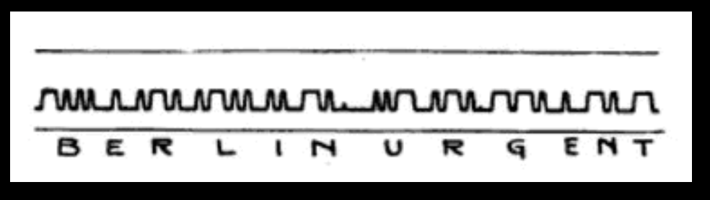
Message example

Slide 9
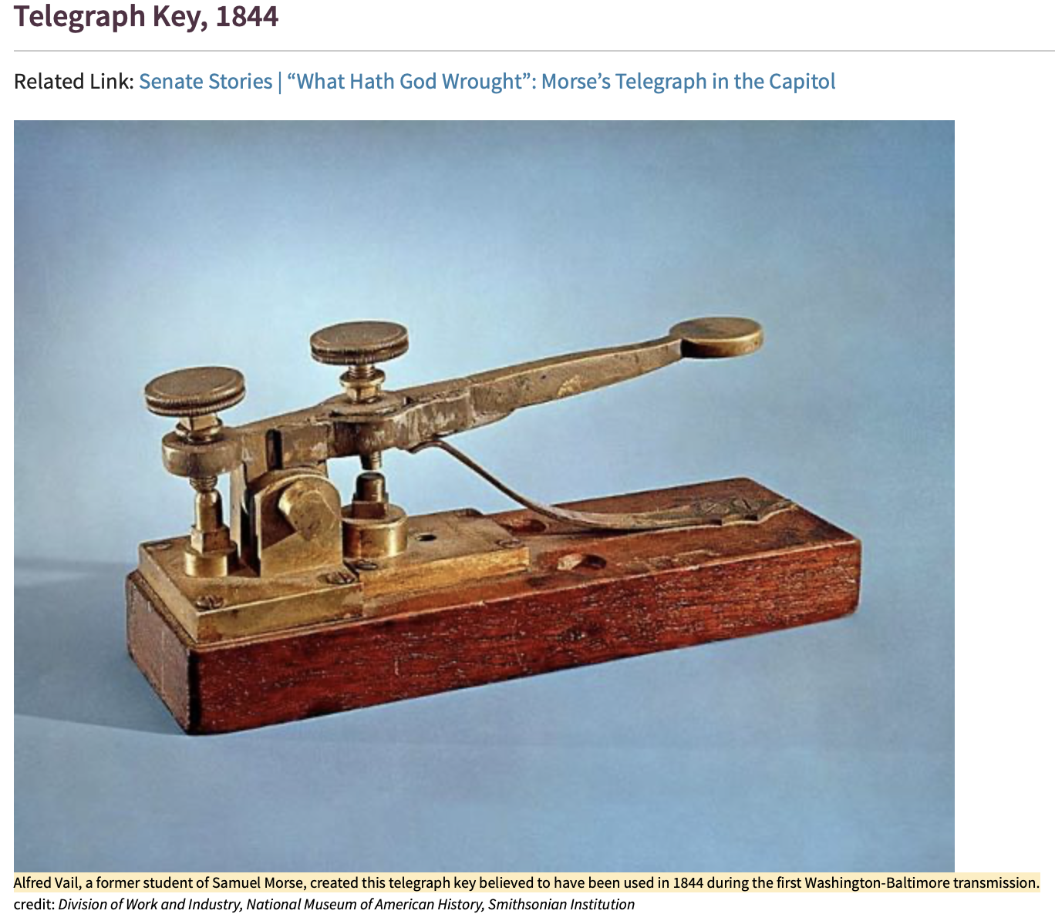

Slide 10

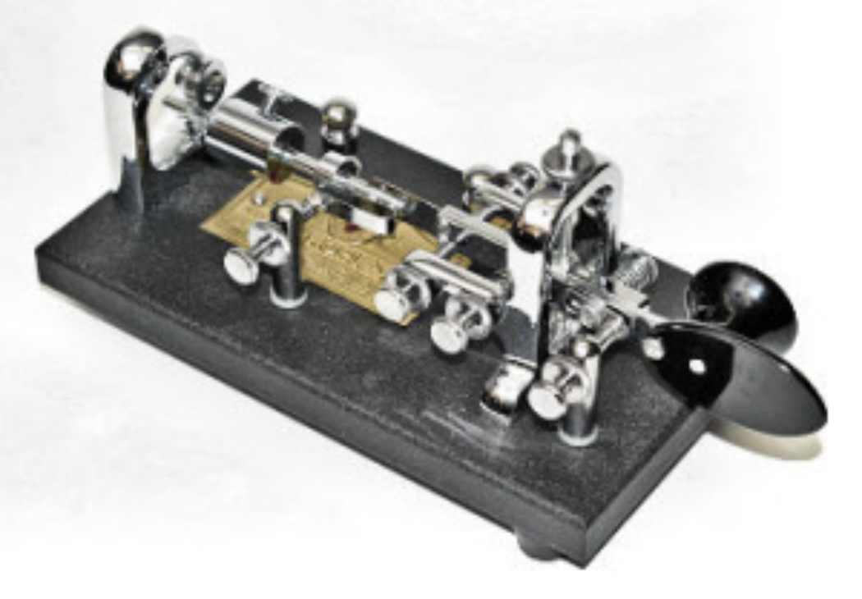
Vibroplex 1905
Horace Martin & ‘bug’ Morse…

Slide 11
First public demonstration 1844
Washington to Baltimore railway line $30k
1st message: “What hath God wrought”
1st transatlantic cable laid 1858 Newfoundland to Ireland
1st wireless morse message 1897 (Marconi)

Slide 12
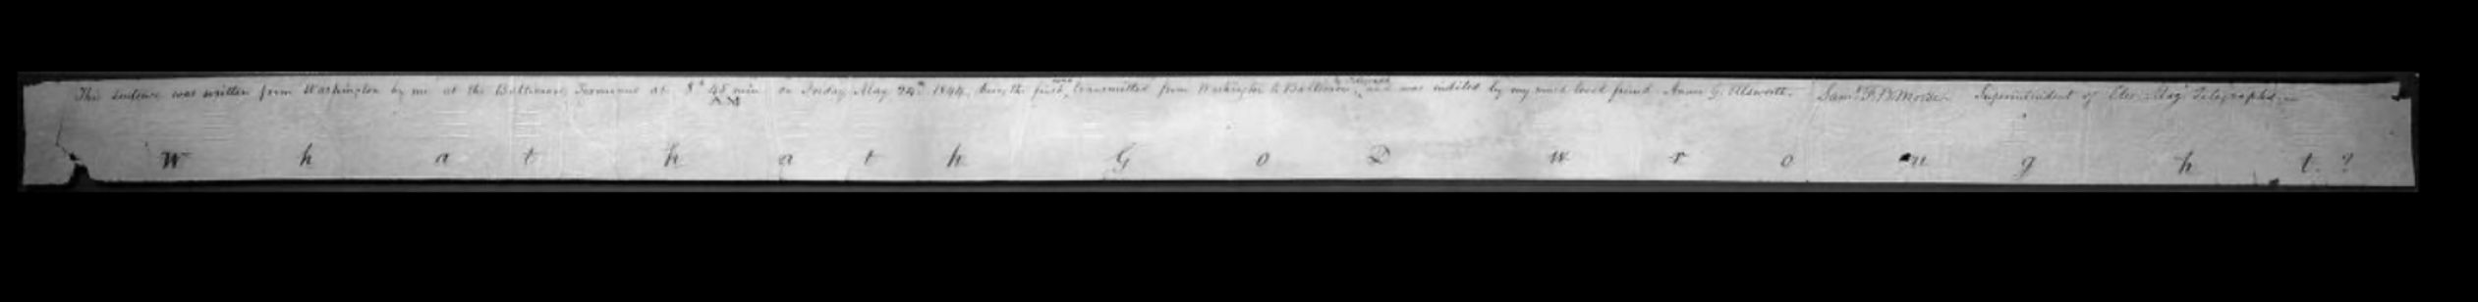
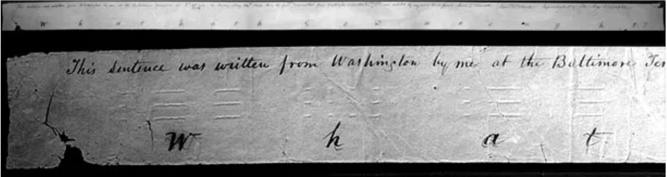
The first & last message! (1844/1997)
What hath God wrought?

Slide 13
A more well known message?
I just saved a bunch of money on my car insurance………..

Slide 14
1 dit between characters
3 dits =1 Dah
3 dits between letters
7 dits between words

Slide 15
FISTS
What makes a good fist?
a. Make your dits & Dahs sufficiently different to tell them apart.
b. Leave enough SPACE between letters to know when they start & stop.
c. Leave even more space between the words to know where they start & stop
d. Be consistent.

Slide 16
The first ‘fist’ complaint?
Everything worked well yesterday, but there is one defect in your writing which I wish you would pay particular attention to make a longer space between each letter, & a still a longer space between each word. The letters and words are often confounded for want of this simple attention.
S.F.B. Morse - May 1, 1844

Slide 17
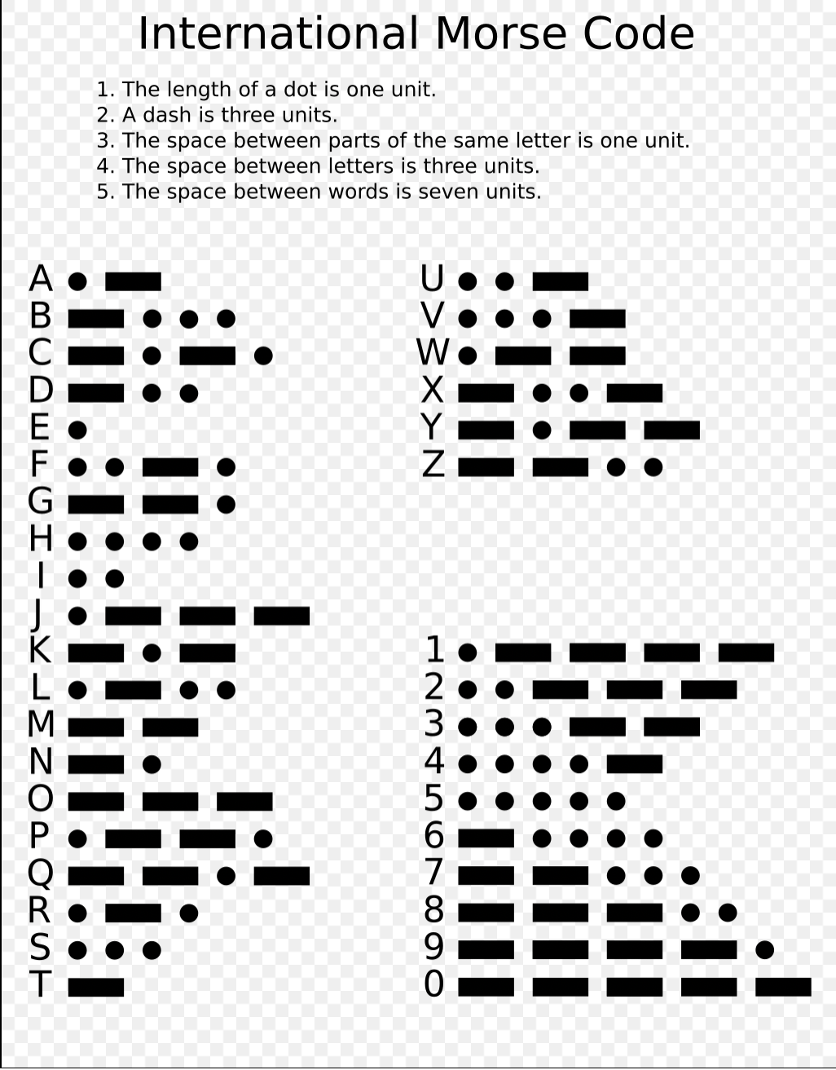

Slide 18
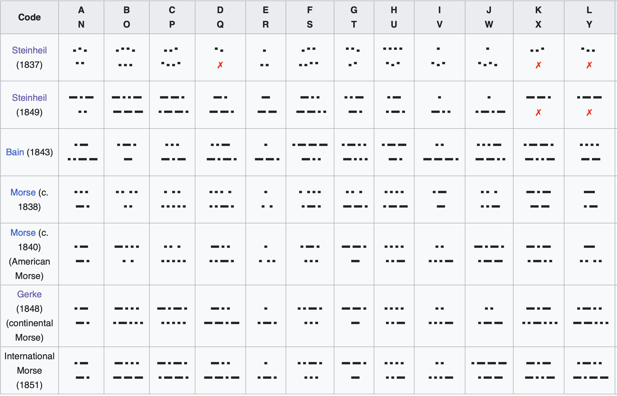
Previous codes

Slide 19
A word from a telegrapher…..
PARIS, CODEX.

Slide 20
Lingua franca? ENGLISH!
a language that is adopted as a common language between speakers whose native languages are different

Slide 21
SV1 RUX DE GW4 OKT, TNX FER CALL OC UR RST 579 ES OP KES KES, QTH NR CHESTER CHESTER ES RNG 5TTW TO LOW DIPOLE.
WX CLDY TEMP 15C HW? BK

Slide 22
dD Dddd DdDd Ddd d ddDd DDd dddd dd dDDD
A B C D E F G H I J
D = DAH = line
d = di or dit = dot
Morse is a dot & line code

Slide 23
Practice by code talking…
CHESTER
DdDd ddd d ddd D dDd
Dah di Dah dit di di di dit dit di di dit Dah dit di Dah dit

Slide 24
E I S H T MO
d dd ddd dddd D DD DDD
Elephants in straw hats three miles off

Slide 25
Opposites
A & N dD Dd
G & W Ddd dDD
B & V Dddd dddD
P & X dDDd DddD
F & L ddDd dDdd
Q DDdD Here comes the Queen

Slide 26
Overscored letters = no spaces.
WR @ dDDdDd
SOS dddDDDddd
BT Pause DdddD
# SOS was developed from German maritime regs, made official
in 1908.

Slide 27
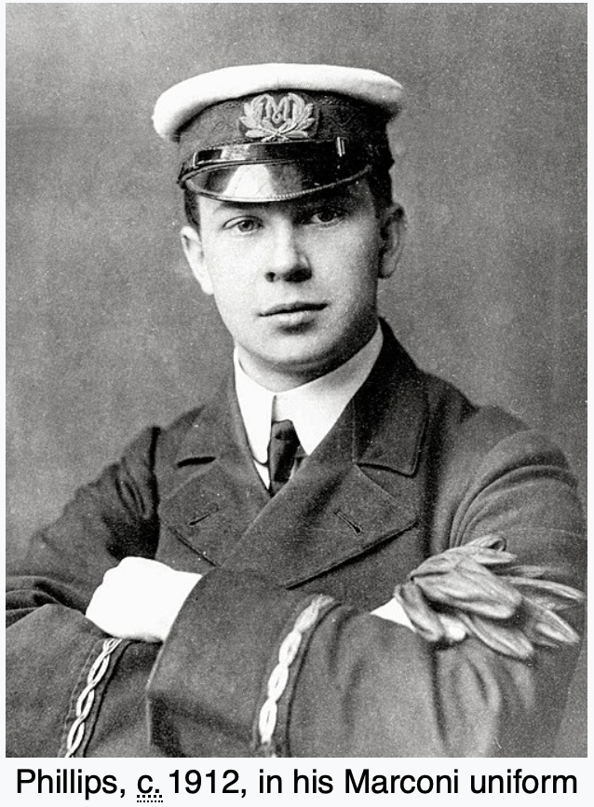
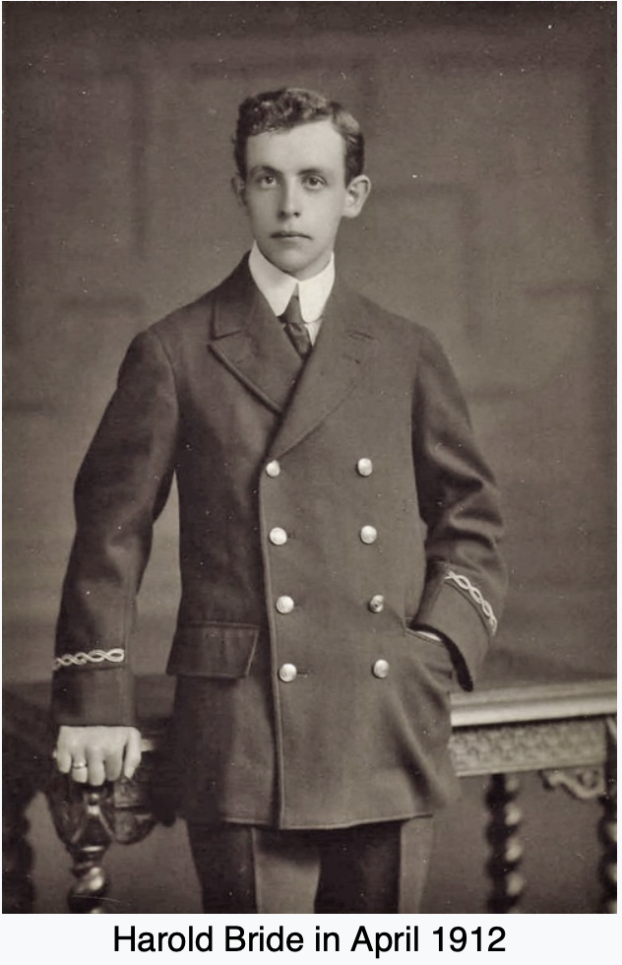
RMS Titanic

Slide 28
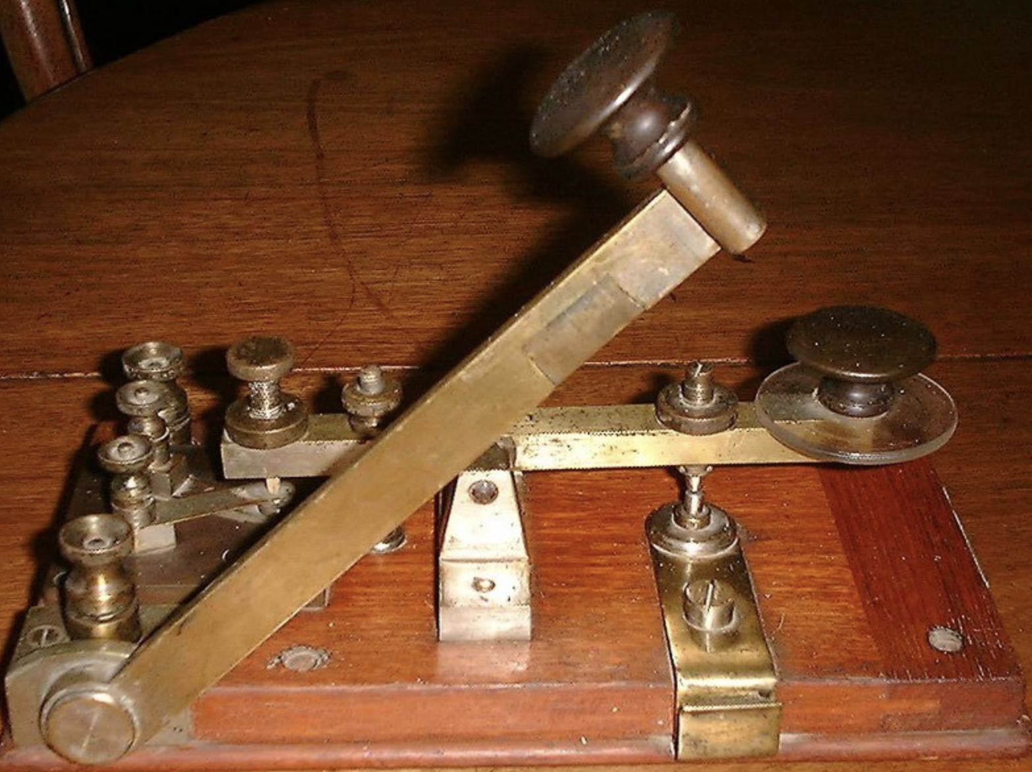
The Marconi ‘Guillotine’ Key

Slide 29
Farnsworth method?
….to send letters at one speed but make the separation between them larger than normal.
T O O F A R A P A R T ?
Should not be used for routine sending or extensive practice because it derails the dit train!

Slide 30
Drills
Best bent wire ……
The quick brown fox jumps over the lazy dog
Alphabet
Difficult common words
Troublesome letters/numbers
QSO examples
Useful phrases

Slide 31
Q codes….
QRL is the frequency in use/the frequency is in use. DDdD dDd dDdd
QRV ready to go on air. DDdD dDd dddD
QRT shutting down. DDdD dDd D
QRZ ? who is calling? DDdD dDd Dddd
QRX wait/standby DDdD dDd DddD
QSY change frequency DDdD ddd DdDD
QRG frequency DDdD dDd Ddd
QRS send slower DDdD dDd ddd
QRQ send faster DDdD dDd DDdD
QLF ? DDdD dDdd ddDd
? ddDDdd

Slide 32
Hello/goodbye/thanks etc….
Hej: Helllo/goodbye (Scandinavia)
Bedankt voor het QSO: Thanks for the QSO (Dutch)
Tot ziens: Goodbye (Dutch)
Ciao: Hello/godbye (Italian)
Adios : Goodbye (Spanish)
DSW: Do svidanya. Goodbye (Russian)
SPB: Spasibo. Thanks (Russian)
Poka: See you (Russian)
DPB: Do pobachennya: Goodbye (Ukrainian)
Ahoj: Hello/see you! (Czech & Slovak)
AWDH: Auf Wiederhören. Till I hear you again (German)
MCI: Merci. Thanks (French)

Slide 33
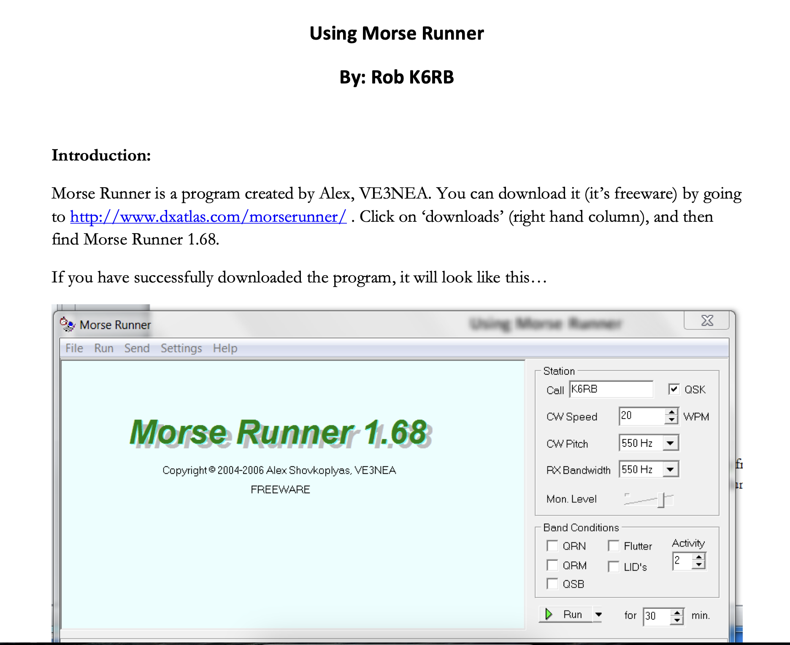

Slide 34
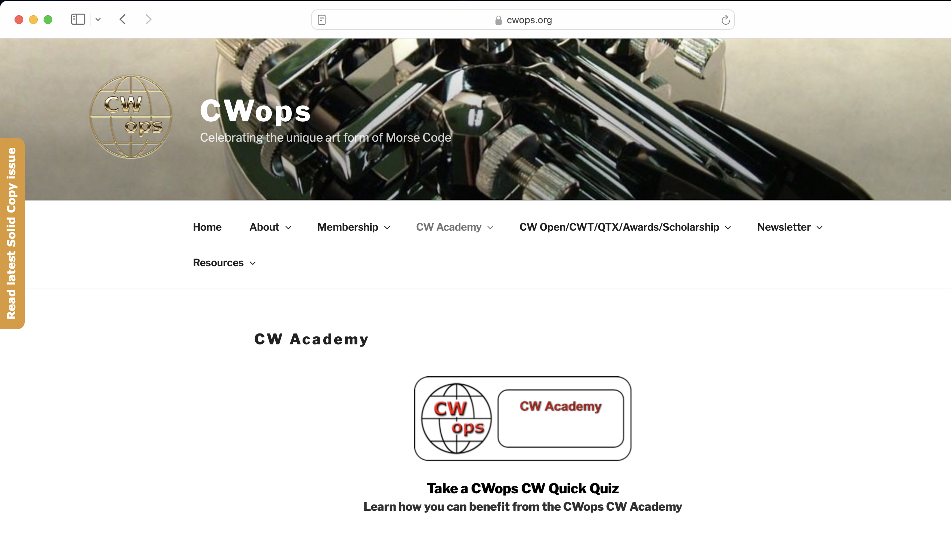

Slide 35
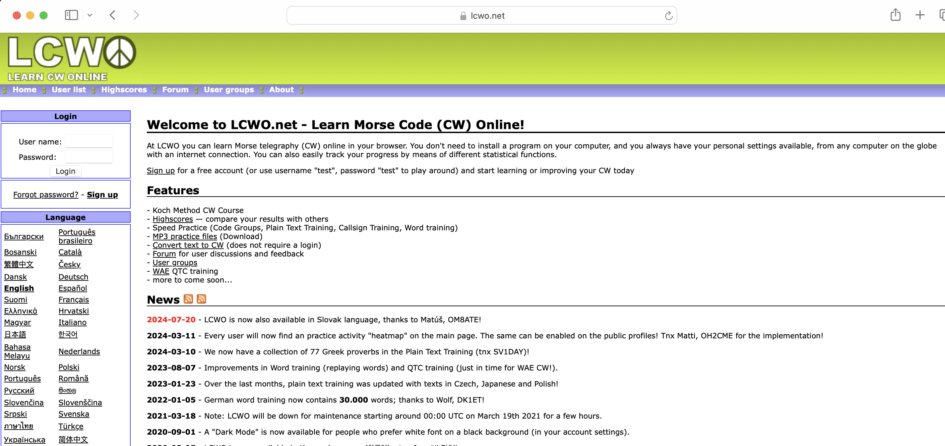

Slide 36
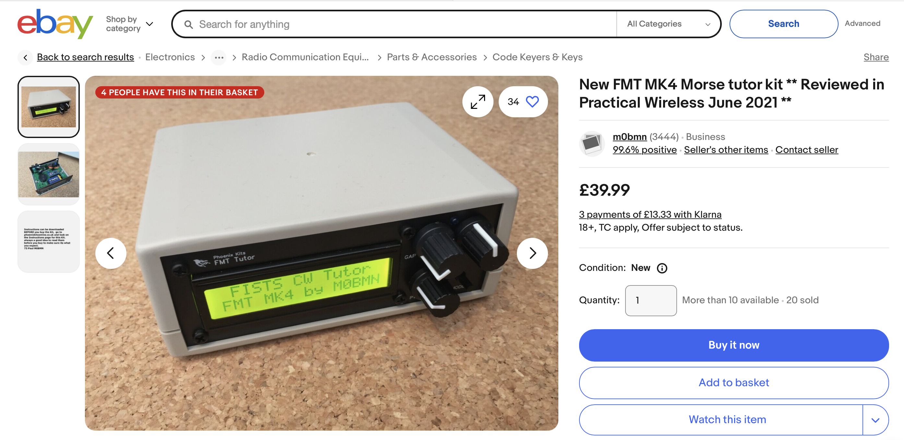

Slide 37
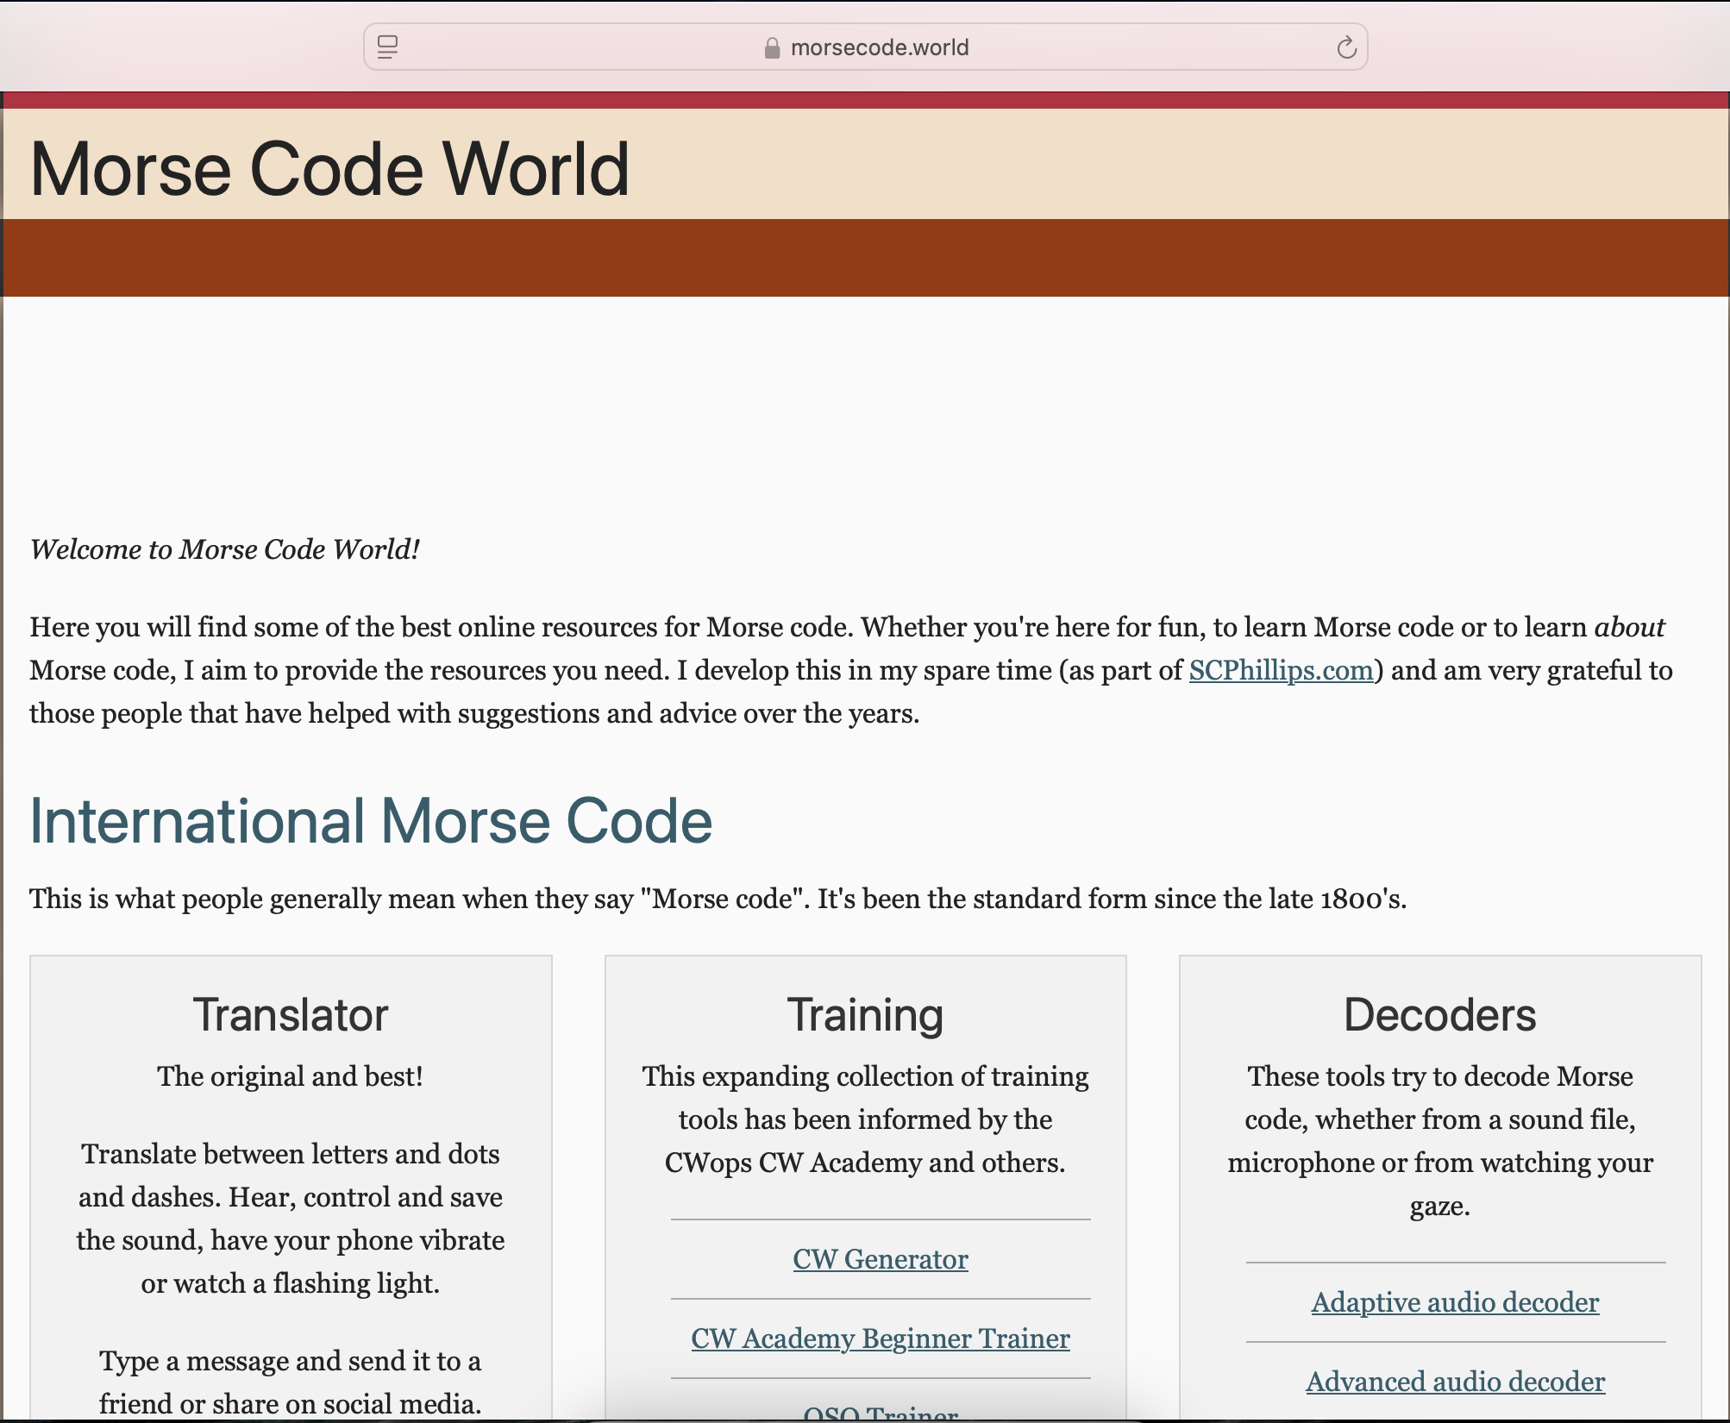

Slide 38
