Slide 1
QRP Transceivers
GW4OKT

Slide 2
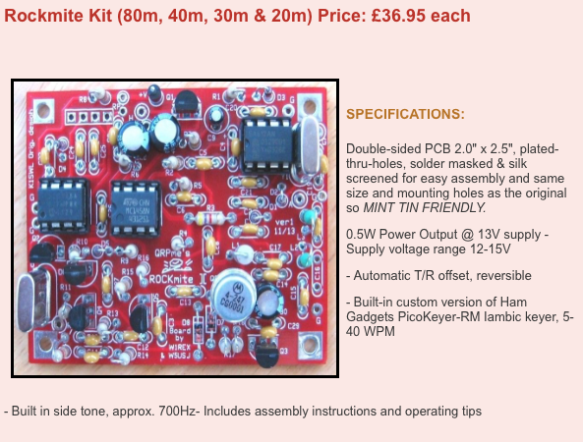
Rockmite

Slide 3
Foxx-3

Slide 4
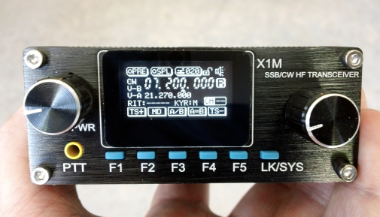
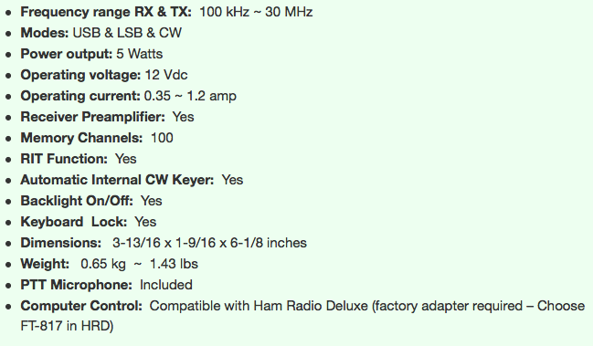
X1M
£250

Slide 5
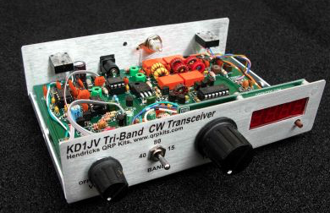
Weber tri-bander
$220

Slide 6
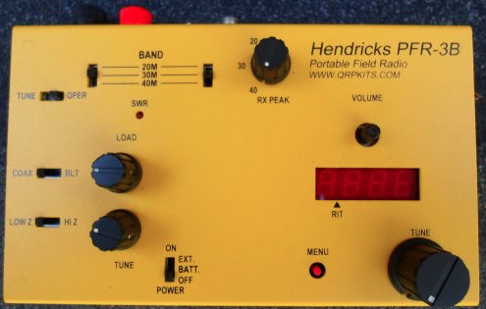
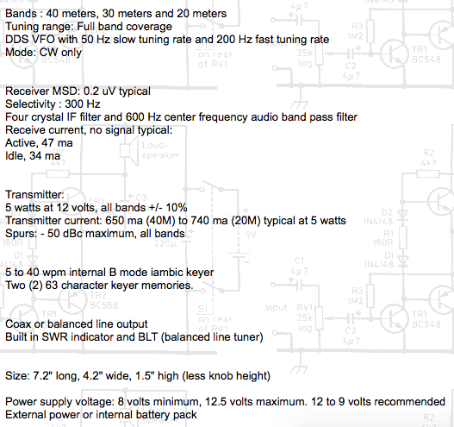
PFR-3
$285, box included.

Slide 7
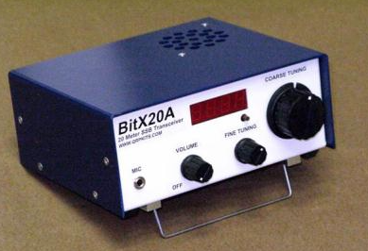
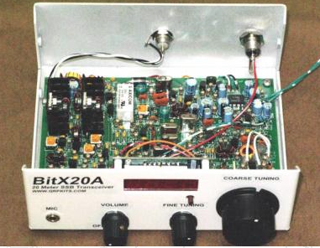
Bit X20A
Also available for 17m. SSB 5W. $200

Slide 8
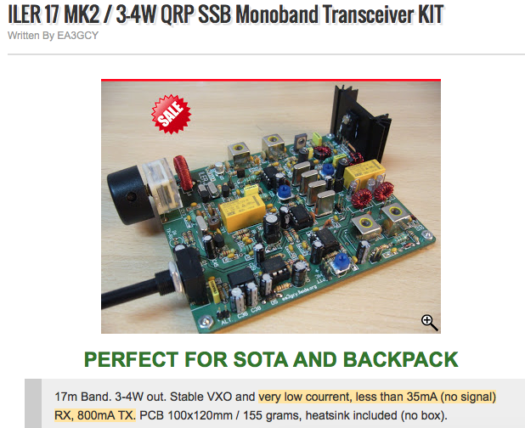
ILER - 17
130 Euros for DDS version.
3-4 watts SSB
Has good reviews on Eham.net, also
available for 20m & 40m

Slide 9
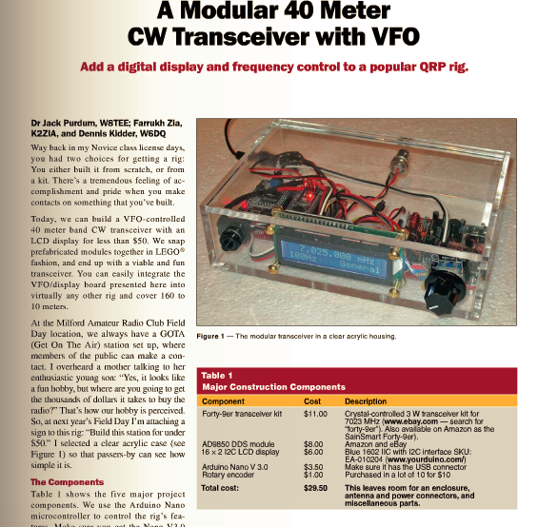

Slide 10
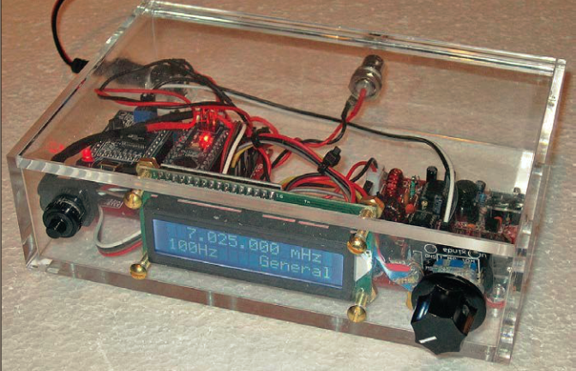

Slide 11
